Slide 1
Youth Works
The regrowth of Youth Work in Our City

Slide 3
Why Youth Works Is Needed
•Youth and Play Work is not a ‘Statutory Service’ and funding is not protected
• Liverpool City Council ( LCC ) Youth and Play Work budget in 2010 - £9 .5 m a year including 83 Youth and Play Work staff based in the community
• In 2024 – the budget is just under a £1m with only 2 F/T LCC Youth Workers based in the community, and limited number of part time staff
• It is acknowledged there is a national shortage of youth workers; 4,500 youth workers no longer work on the frontline, and recruitment of qualified youth workers has drastically declined
• The drastic budget cuts have resulted in much reduced support for young people, as Youth Service do not have the feet on the ground, or the capacity to meet the young people's needs
• Issues compounded by increased need for support during / post Covid

Slide 4
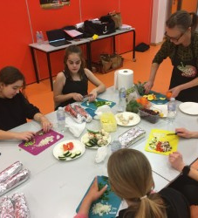
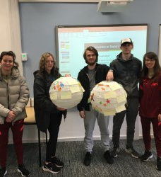
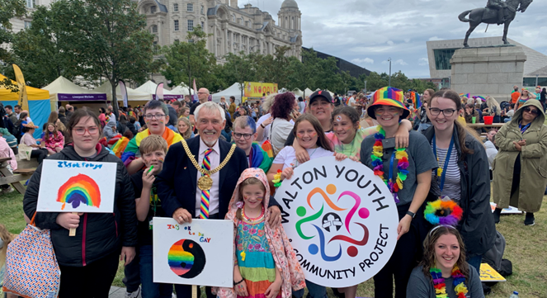
Why Youth Works Is Needed
Increasing universal concern for the health and wellbeing of young people
A need to address the challenges NOW, before issues escalate further
To develop local expertise for the support of young people
To help improve the quality of life within our communities
To help create an environment that encourages investment and growth
In total the first cohort delivered 24,288 hours in the community
Project planning & delivery
Mental health, tackling food poverty, community development, youth participation, detached youth work, tackling ASB.

Slide 5
Meet The Steering Group
Helen Whitfield
Stephen Piscopo
Barbara Murray
Yvonne Maddocks
Julia McNally
Mark Fallon

Slide 6
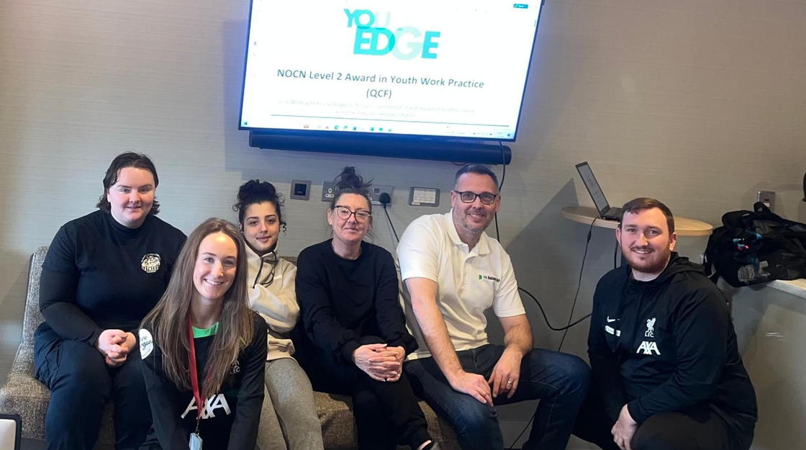
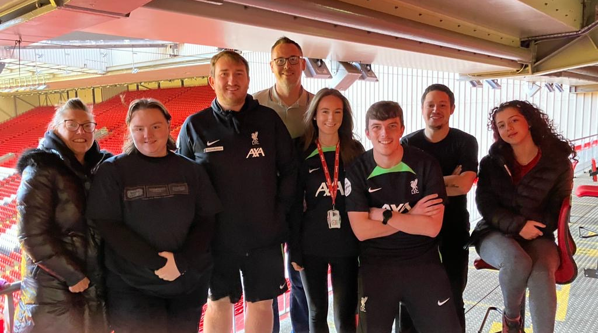
Training Model
•Your Edge: Engage, Develop, Grow & Empower
•Local Youth Worker with over 20 years of experience, working in different work settings.
•18+ who wants to gain a level 3 Diploma in Youth Work Practice (JNC qualified Youth Support Worker). New upcoming or existing Youth Workers.
•Based in a Community/Youth Centre in the Liverpool area
•Gaining practical experience, whilst supporting 8-25 year olds.
•The training provider enables a safe space for apprentices to reflect on their experience to develop their professional skills.
•With the support and guidance from the employer the apprentices put their theory into practice enabling professional growth (progressing from assisting to leading youth programmes).
Subheading

Slide 7
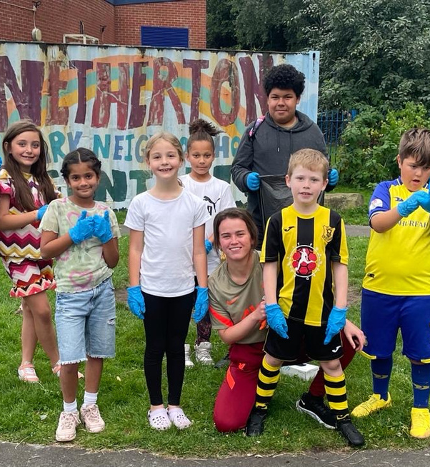
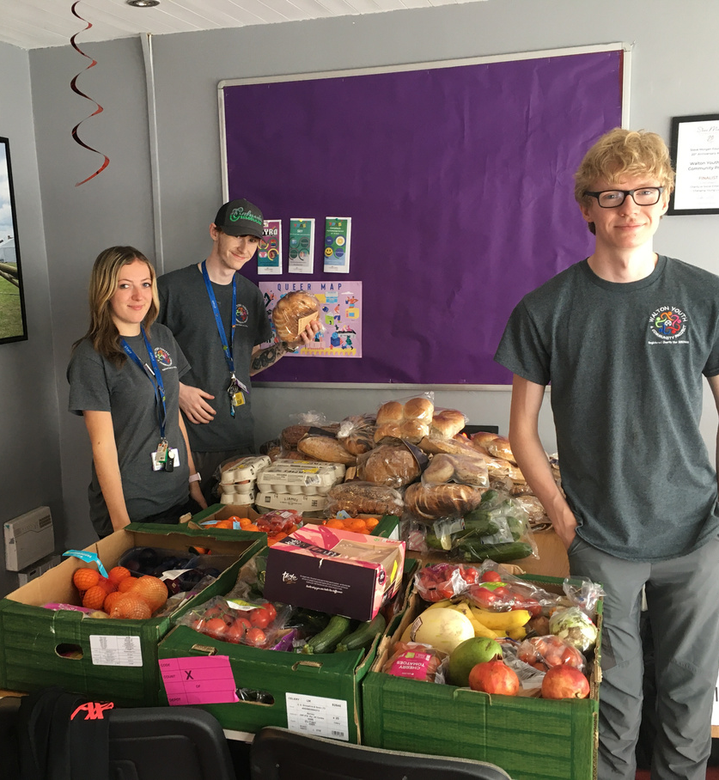
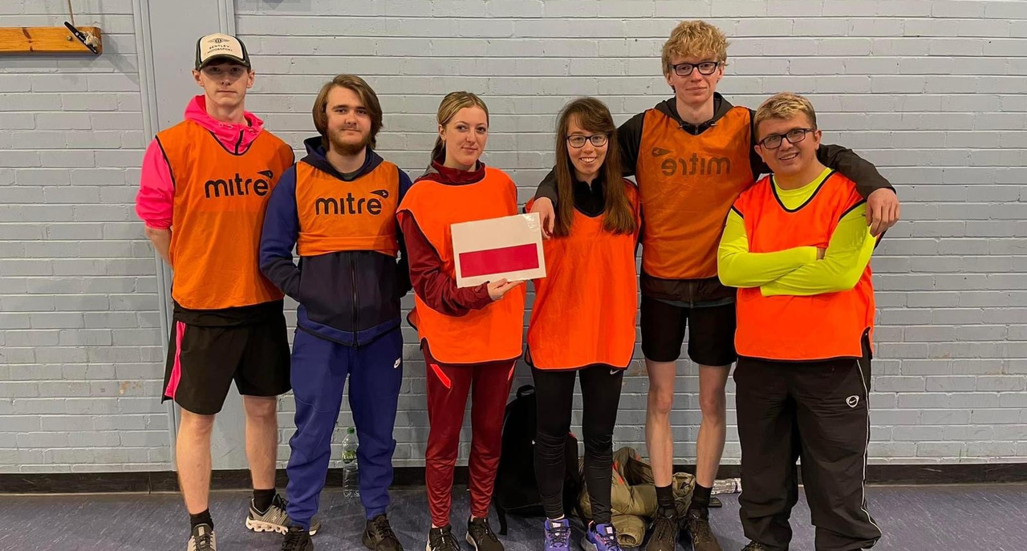
Cohort 1
Youth Employment
•Eight apprentices employed on 30 hours (age 18-24)
•Secondment agreements
•Overall costing: £283,390
•Funders: LEGCT, MVRP & Premier League
•LFC Club Levy - £4500pp
•Recruited 8 passionate young people
•Successfully completed first cohort
•Three participants progressed on a youth work degree
•Two participants recruited at LFC Foundation developing youth work in Anfield ward.
•Two accepted for Camp America
•Obtained funding for cohort two
Subheading

Slide 8
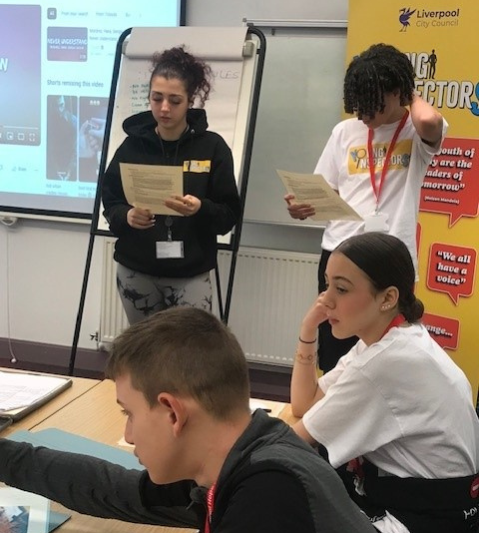
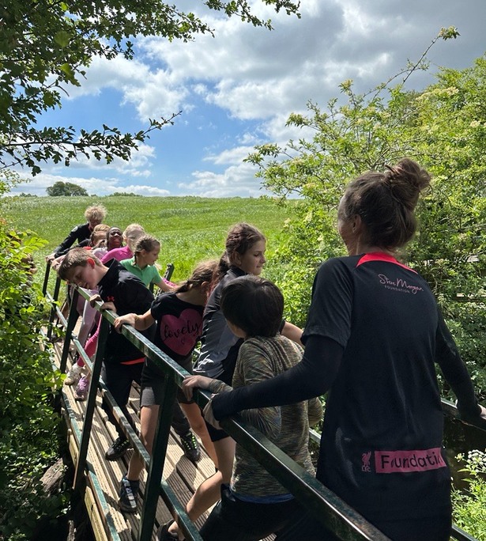
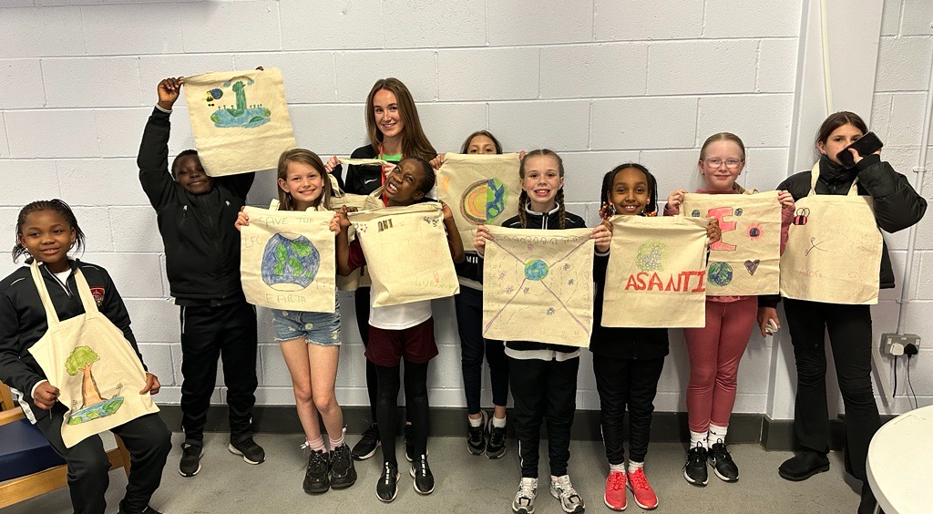
Cohort 2
Wage Supplement Scheme (age 18 plus)
Funding eight apprentices
•Wage top up bringing the cost of the programme down to meet the 30-hour criteria
•Overall costing: £186,662
•LCC, LEGCT, MVRP & Power to Park Lane
•LFC Club Levy - £4500pp
•Hybrid of both delivery model, as we don’t want to exclude participants, but it is funding dependent.
•Cohort two launched - 10 apprentices
LFC Foundation, LCC, Walton Youth Project, Netherton Park Neighbourhood Centre, Yew tree Ward, YPAS & Garston Youth Centre.
Subheading

Slide 9
Meet The Apprentices
Libby Palmobella
Walton Youth Project
Anna Rooney
LFC Foundation
Leah McAteer
LFC Foundation
Ryan Hardy
LFC Foundation
Andreia Defreitas Mendonca
Liverpool City Council
Charlie Whitehead
YPAS
Alisha Farrag
LFC Foundation
Mischa O’Connor
Garston Youth Centre

Slide 10
Meet The Apprentices
Katie Duffy
Walton Youth Project
Clare Peters
Yew Tree Ward
Marie Halsall
Netherton Park Neighbourhood Centre

Slide 11
Cohort Two: Impact at Walton Youth Project
Quarter 1
Jan - March
Engaged with 719 young people
Engaged with 196 adults
Quarter 2
April - June
Engaged with 591 young people
Engaged with 830 adults
Successful for Alder Hey Funding Bid
Planning a ‘safety fair’ for youth and community groups
Supported a 7 week project. Covering: poverty and inequality, mental and physical wellbeing, education, youth work, discrimination and community safety.
Delivered Young Inspector’s Training programme to 20 young people. All young received a AQA
Developed a detached team, delivering three youth nights a week and one targeted service to tackle ASB.
1-2-1 work woth young people
Expanded delivery in all youth centres.
Issue based sessions:
drug awareness, sexuality, cyber bullying, sexual health, health and welbeing
Supported with a 11k funding bid which was successful. Planned and delivered school holiday youth programmes
Supporting young people with complex issues:
Mental health
ASB
Drugs and Alcohol
Racism and Prejudice

Slide 12
Rachael’s Youth Works Journey

Slide 13
Rachael’s Youth Works Journey
Subheading
Notes:
Level 6.
Changemakers- Buckingham Palace.
AXA Event.
Setting up Youth Provision in the Foundation, Youth Nights, Detached (Matchdays & Concerts), Footy Fridays, Fan-Referral Project, Holiday Programmes.
Community Awards Staff Recognition.
Stakeholder relationships- Catch 22, We Are With You, Show Racism the Red Card.
Things to include:
Where I was before
Apprenticeship
Now- Youth Provision, Detached, Matchdays/ Targeted work, Holiday Programmes
Referrals into Youth Provision through social work/ family help...
Level 6

Slide 14
Any questions?
Stephen Piscopo
Department Manager for Employment and Training
Email: stephen.piscopo@liverpoolfc.com
Rachael Rooney
Youth Work Coordinator
Email:
rachael.rooney@liverpoolfc.com

