Slide 1
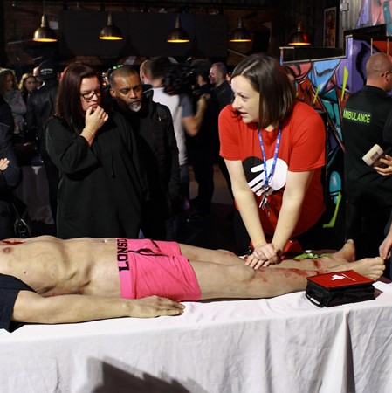
KnifeSavers™
Bleeding Control Education
Dr Nicole Russell
Co-Director KnifeSavers ED Consultant Whiston Hospital

Slide 2
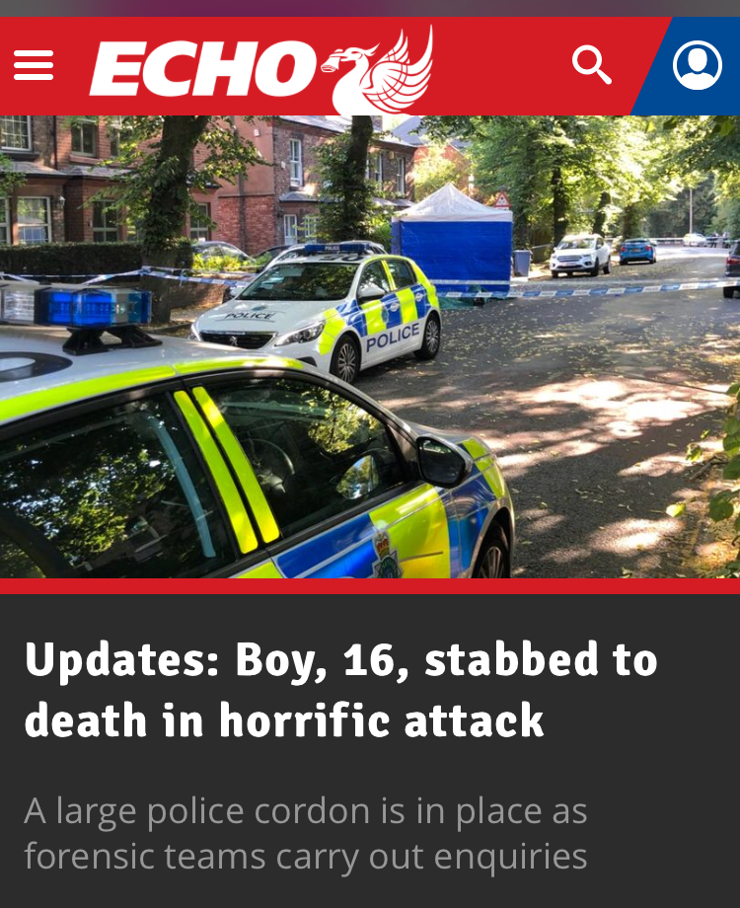
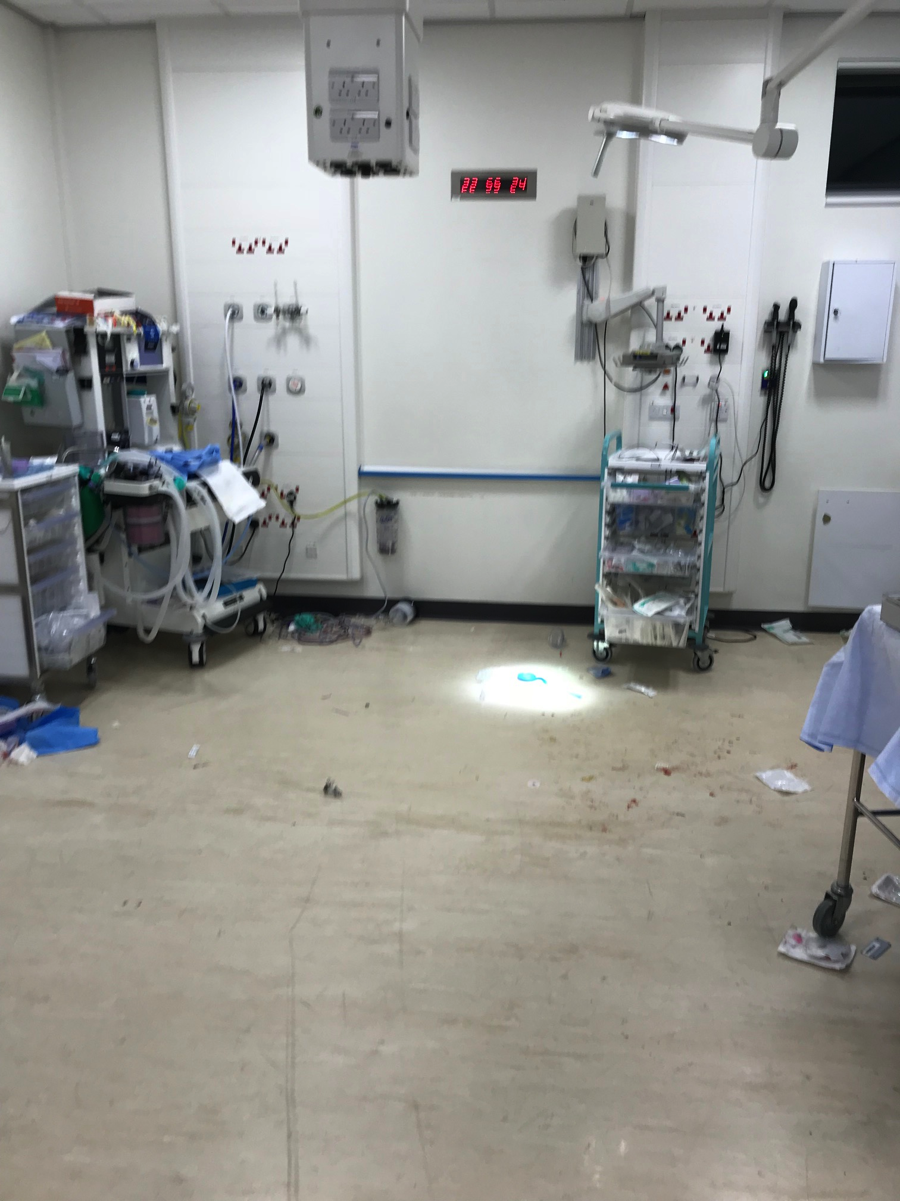
Notes:
Take you back to July 2018, sun is shining and 28 teenagers gathered on a field. A straightener or a fight was called and a 16 year old was killed by a single stab wound to his femoral artery.
This is his resus room following that incident. It’s messy, but there isn’t any blood. His whole circulating volume was on that floor In the middle of the street as his mum screamed at him to survive.
This is one of many stories in our city and wider area, single stab wounds causing catastrophic bleeding

Slide 3
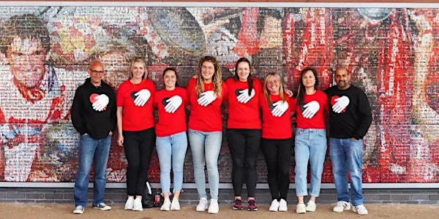
Aim of campaign
To educate and empower literally everyone how to control major bleeding

Slide 4
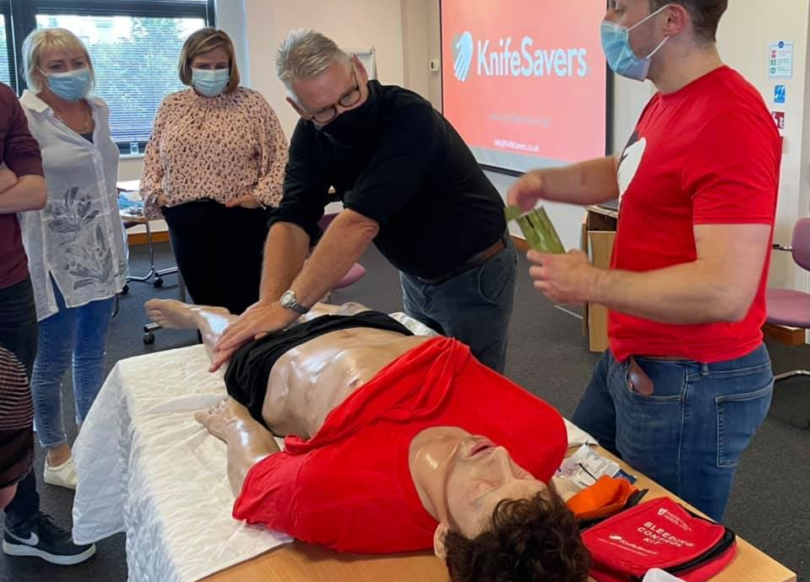
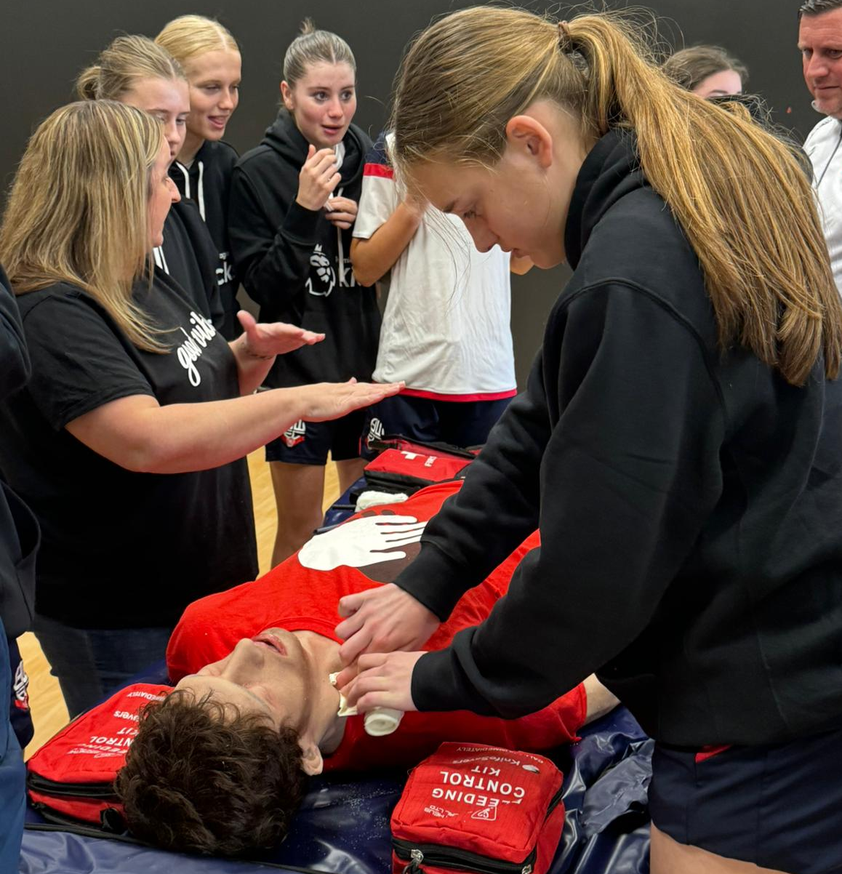
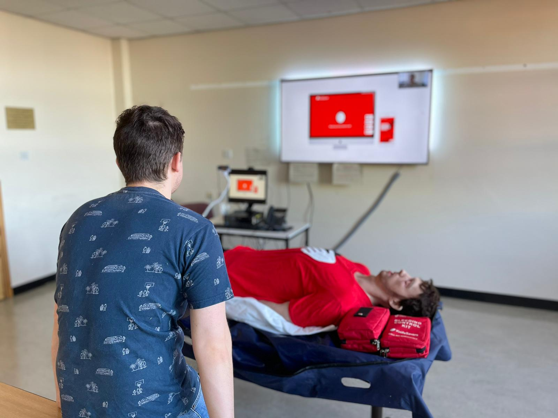
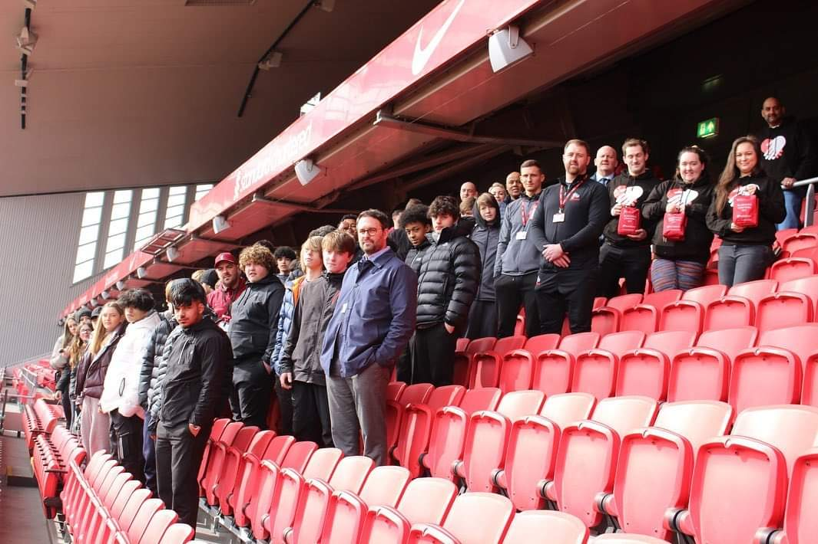
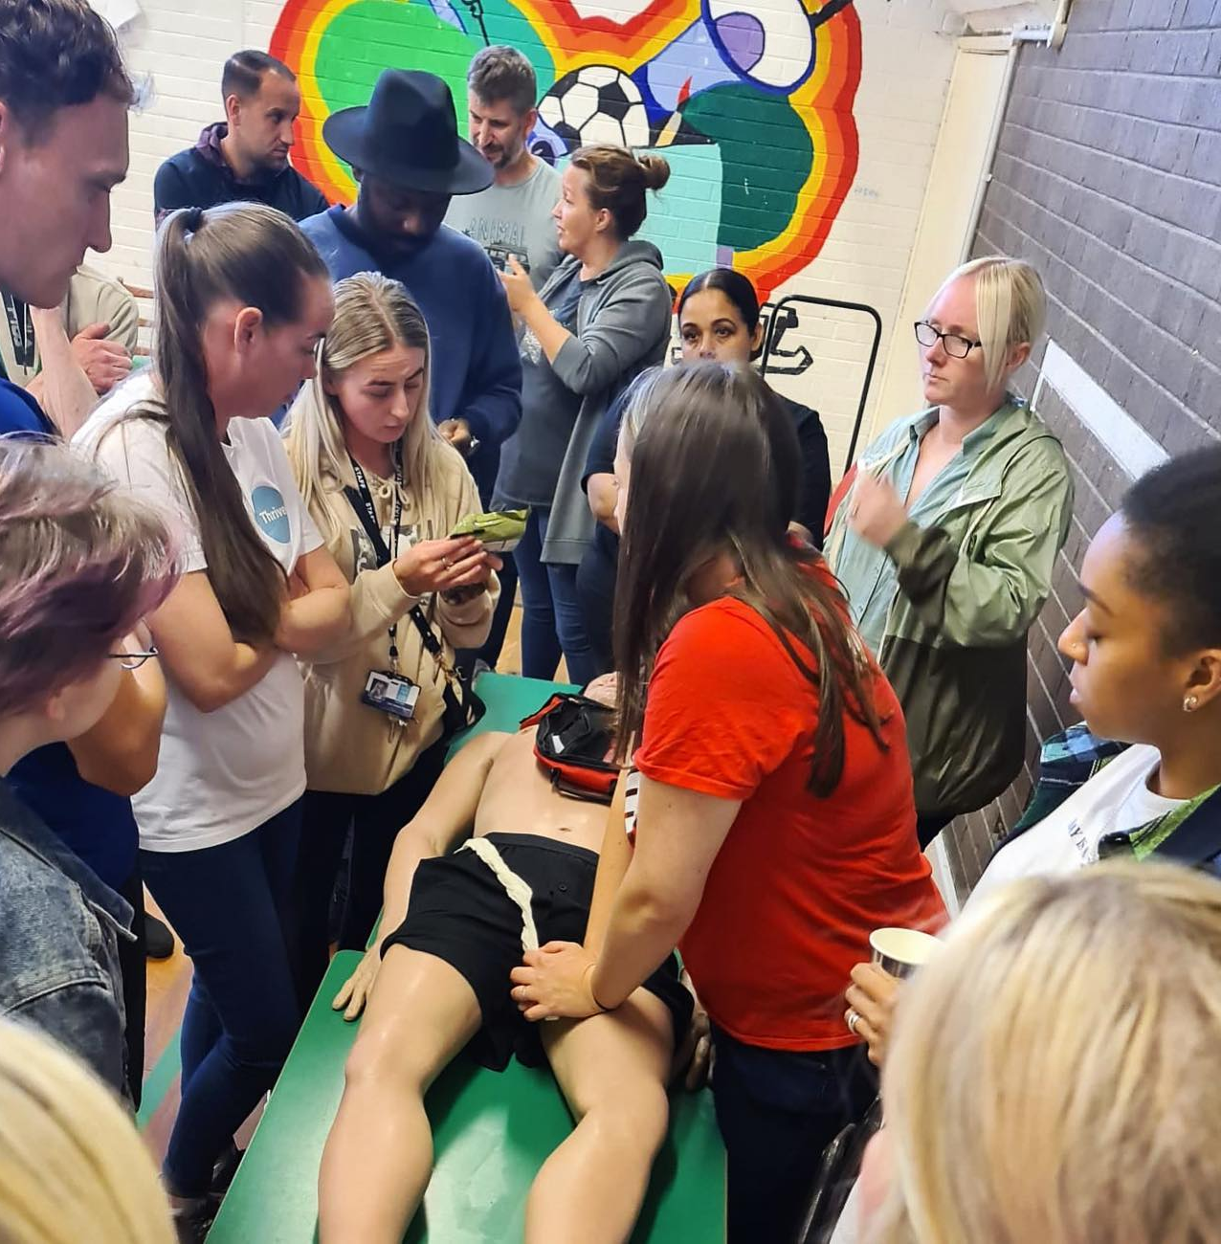
Education

Slide 5
Education
A
Make sure you are safe.
Call 999.
lert
B
Where exactly is the bleeding coming from?
leeding
C
Press hard with 2 hands.
ompress to Control

Slide 6
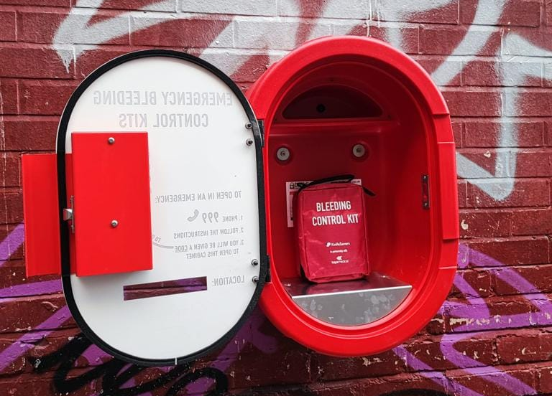
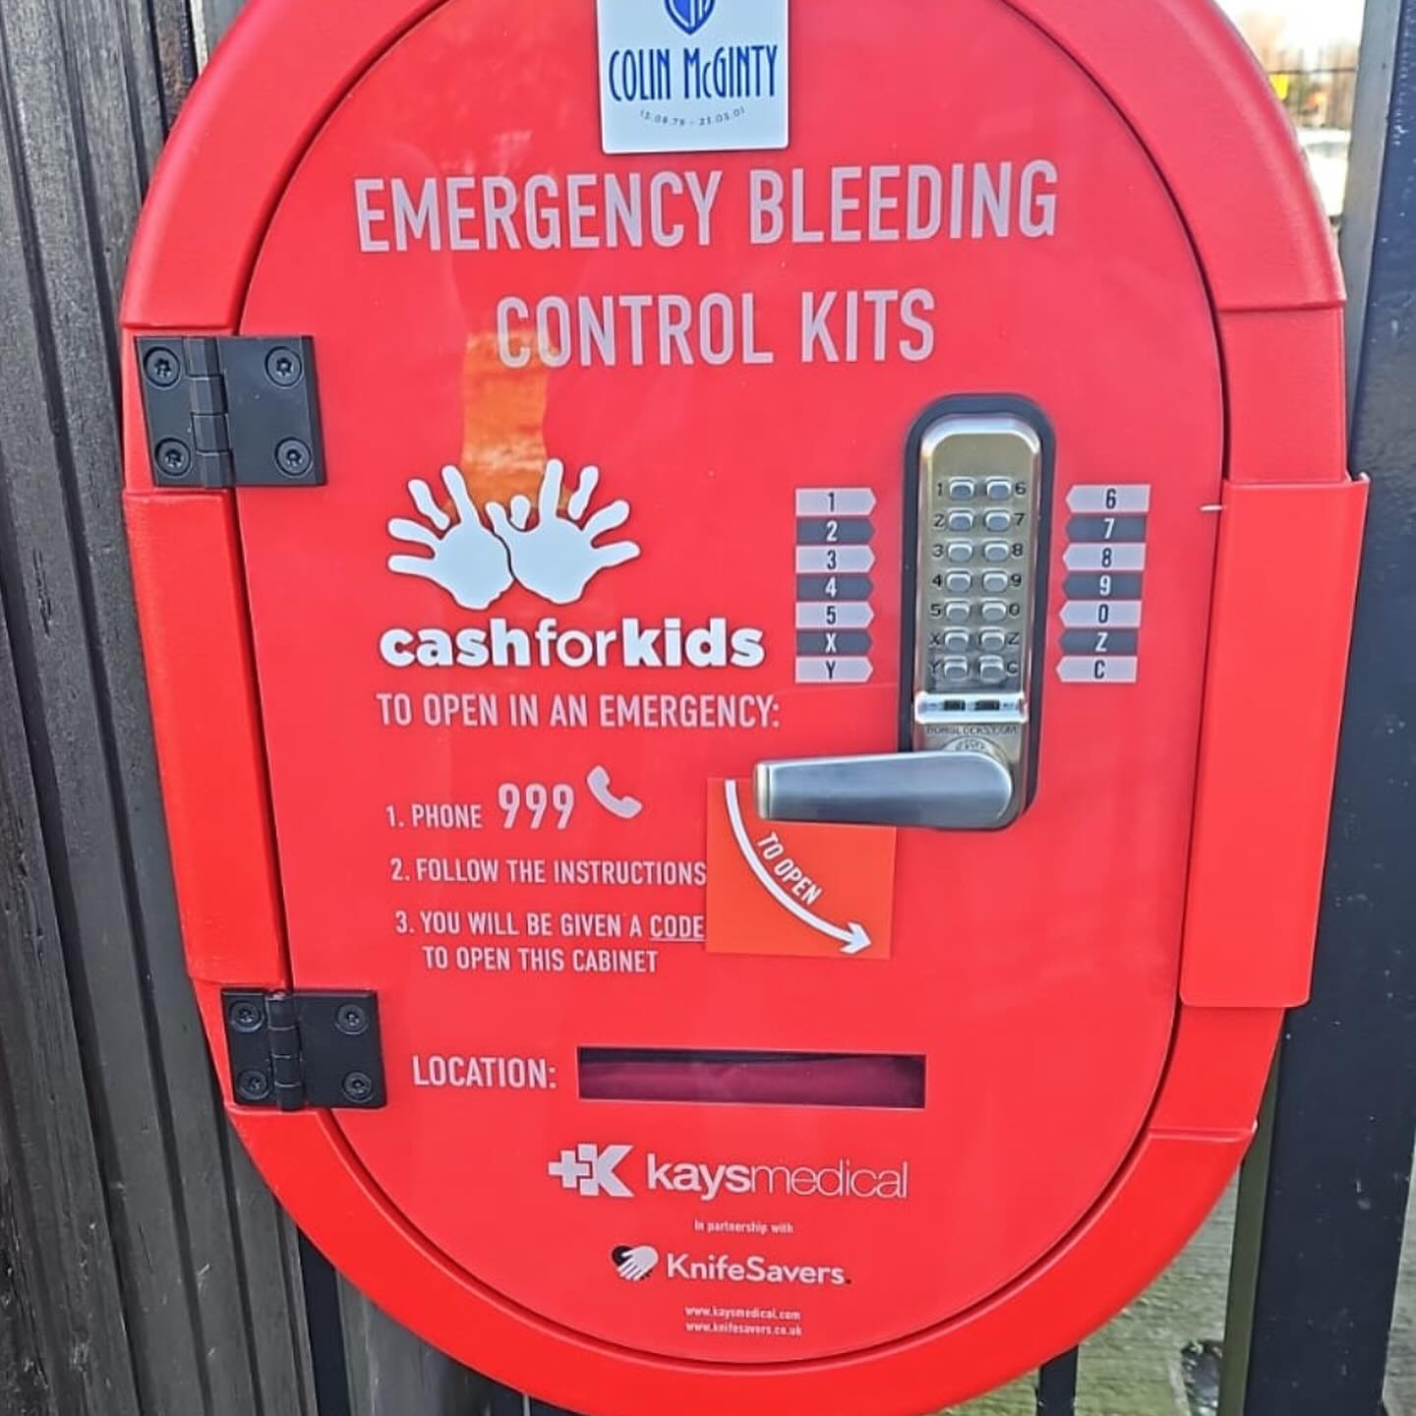
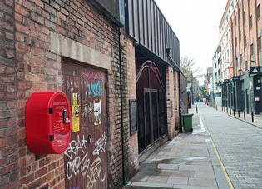
Kits & Cabinets

Slide 7
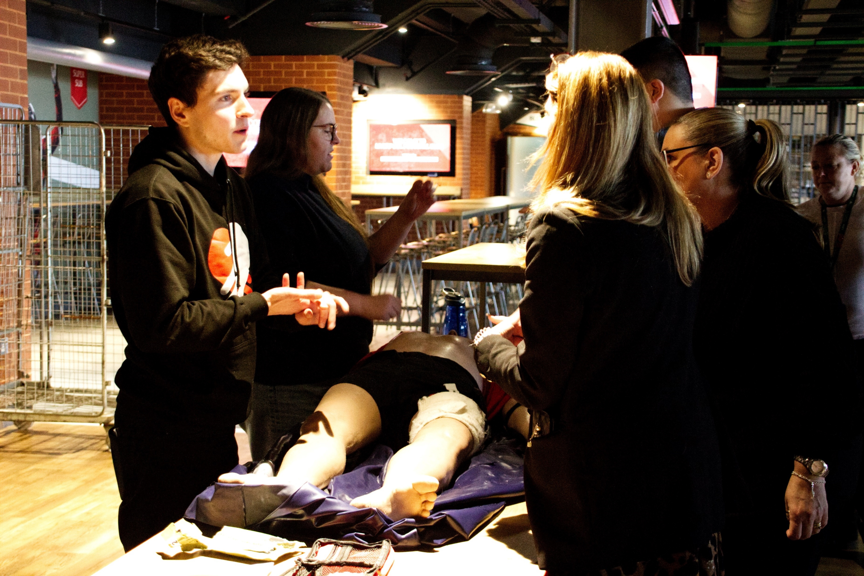
Case Example – Anfield Schools

Slide 8
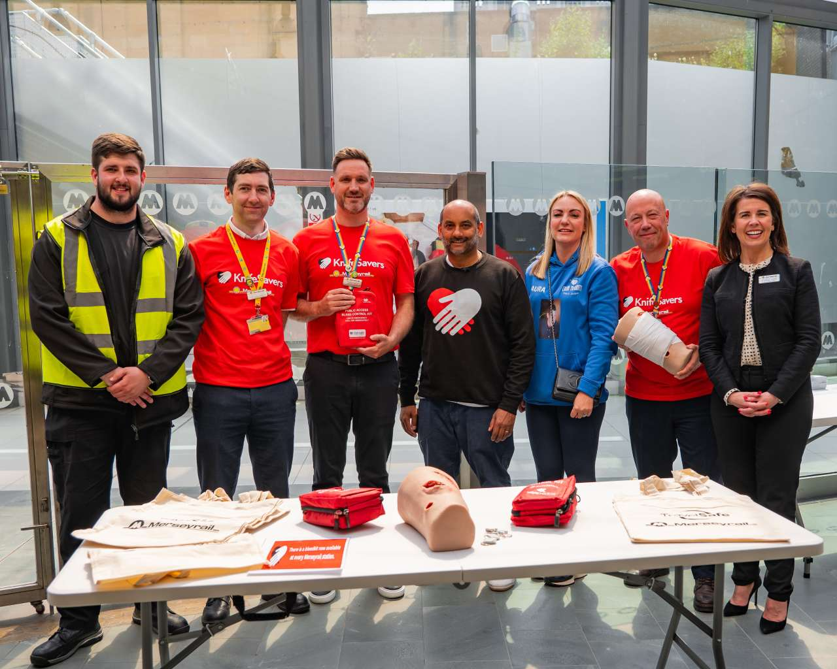
Case Example – Merseyrail

Slide 9
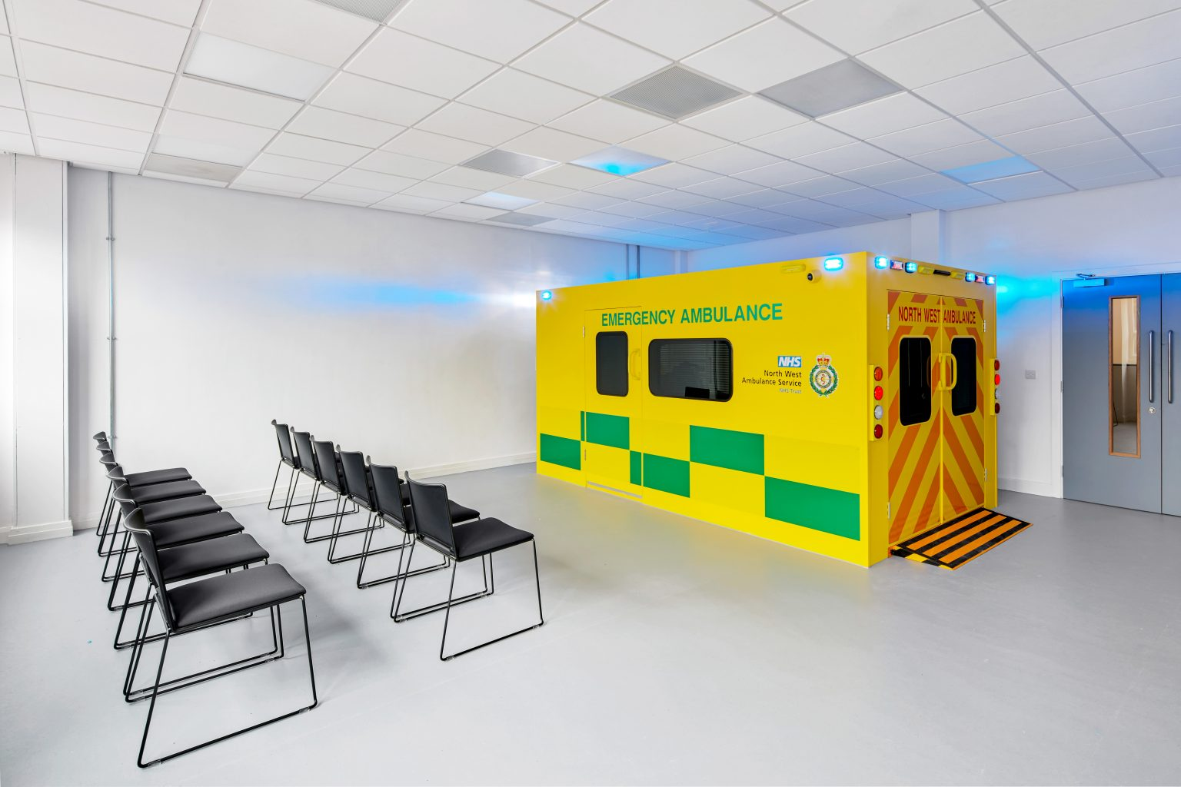
Case Example – LMJU
“We are delighted that more than 1,000 of our students can go out into the world better prepared for this type of emergency care.” Kev Cairns, a lecturer in clinical skills and simulation

Slide 10
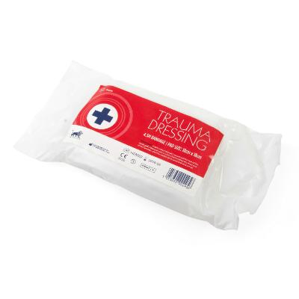
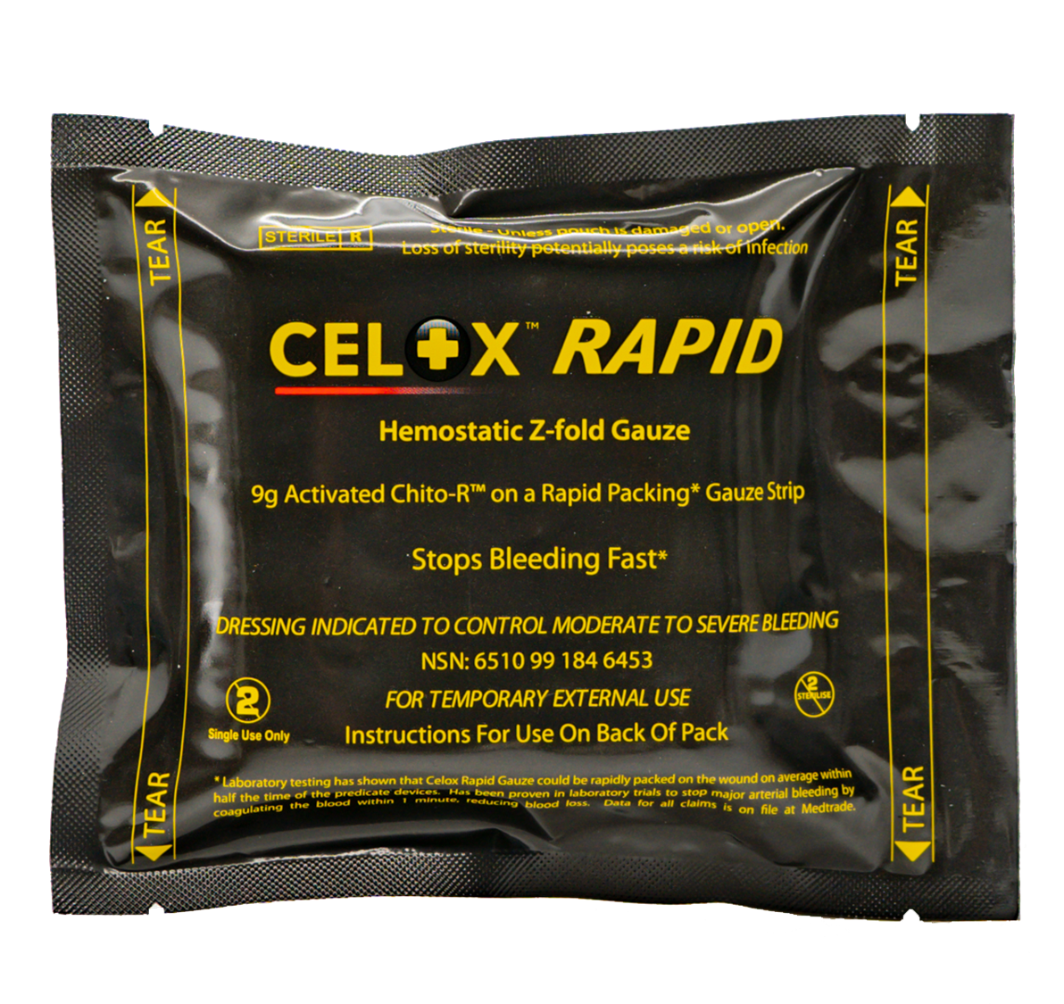
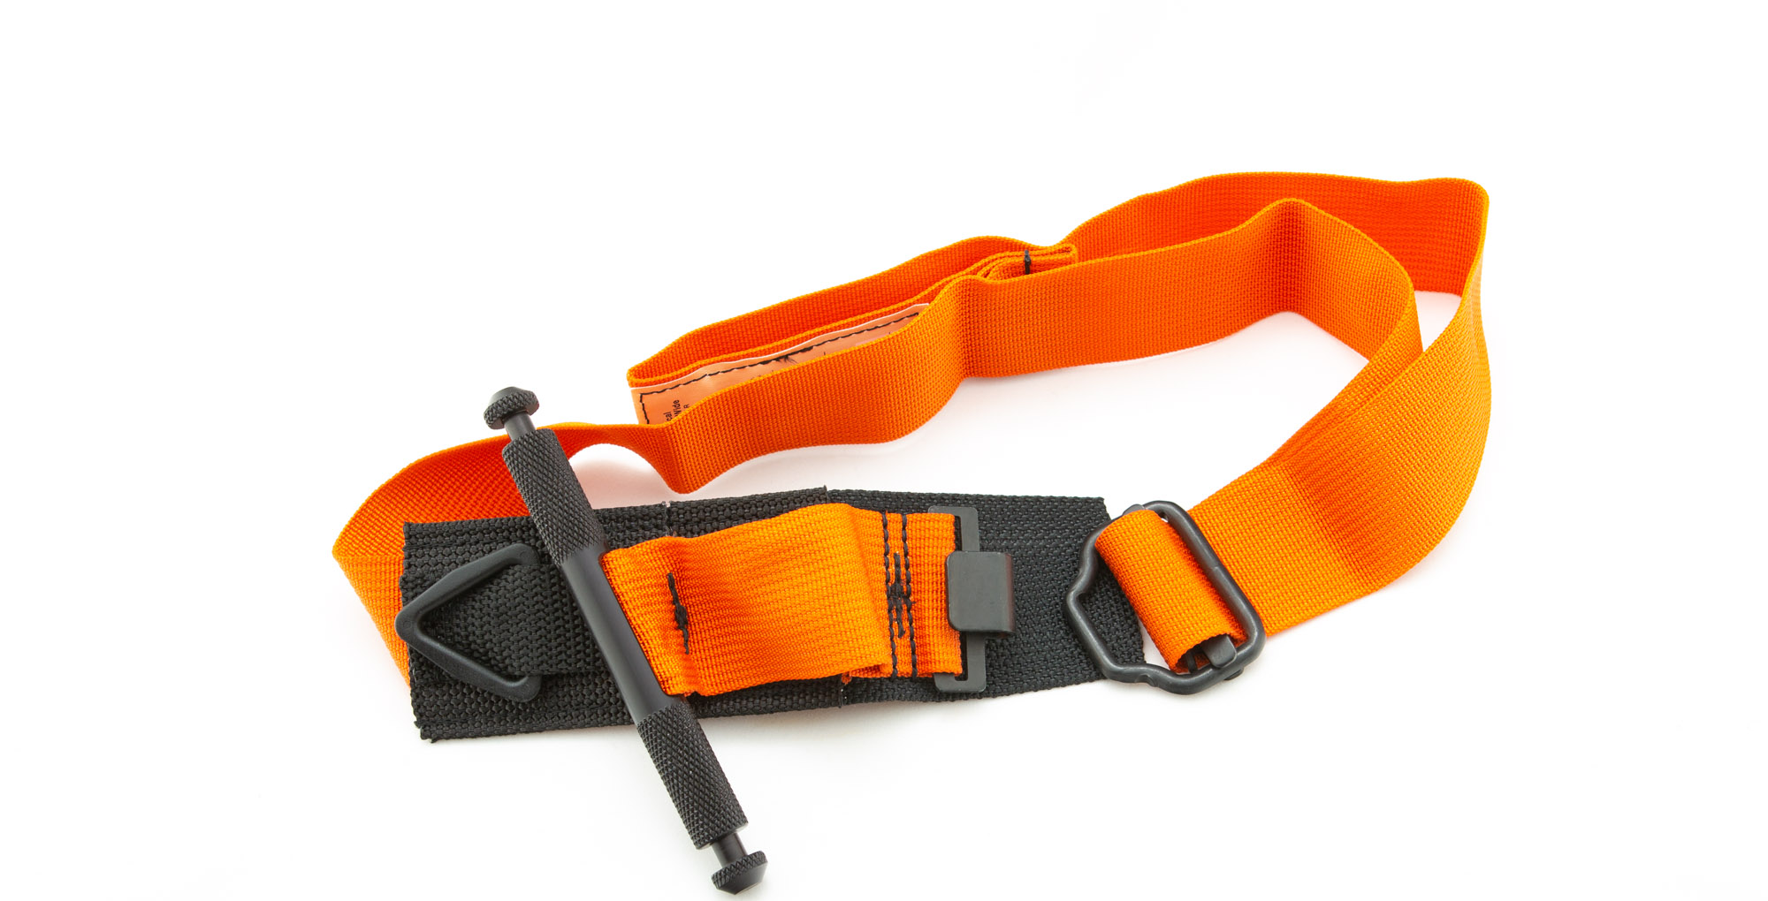
1
2
3

Slide 11
Awareness

Slide 12
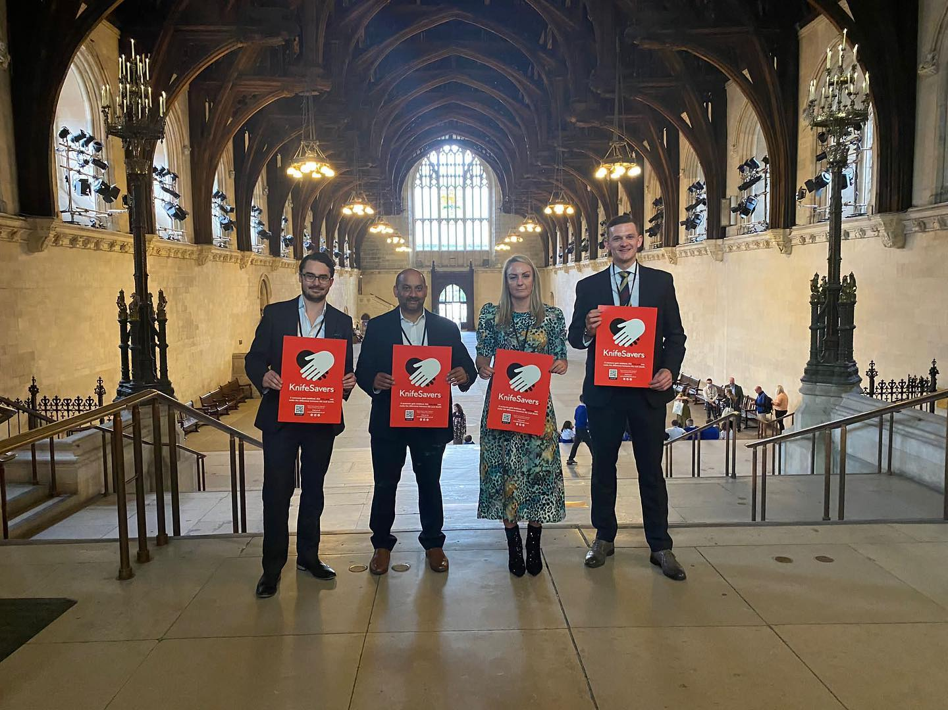
Awareness

Slide 14
Is it worth it?
ONS data suggests 3888 hospital admissions in England and Wales for assault with sharp object in year 23/24
>5500 People Trained
>3000 Bleeding Control Packs
150 Bleeding control cabinets
2000 App Users
150 HCP trainers

Slide 15
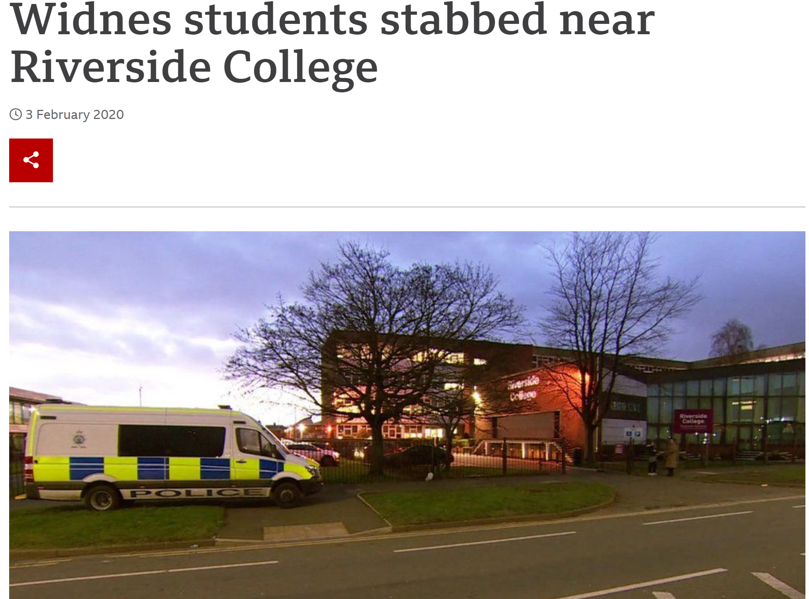
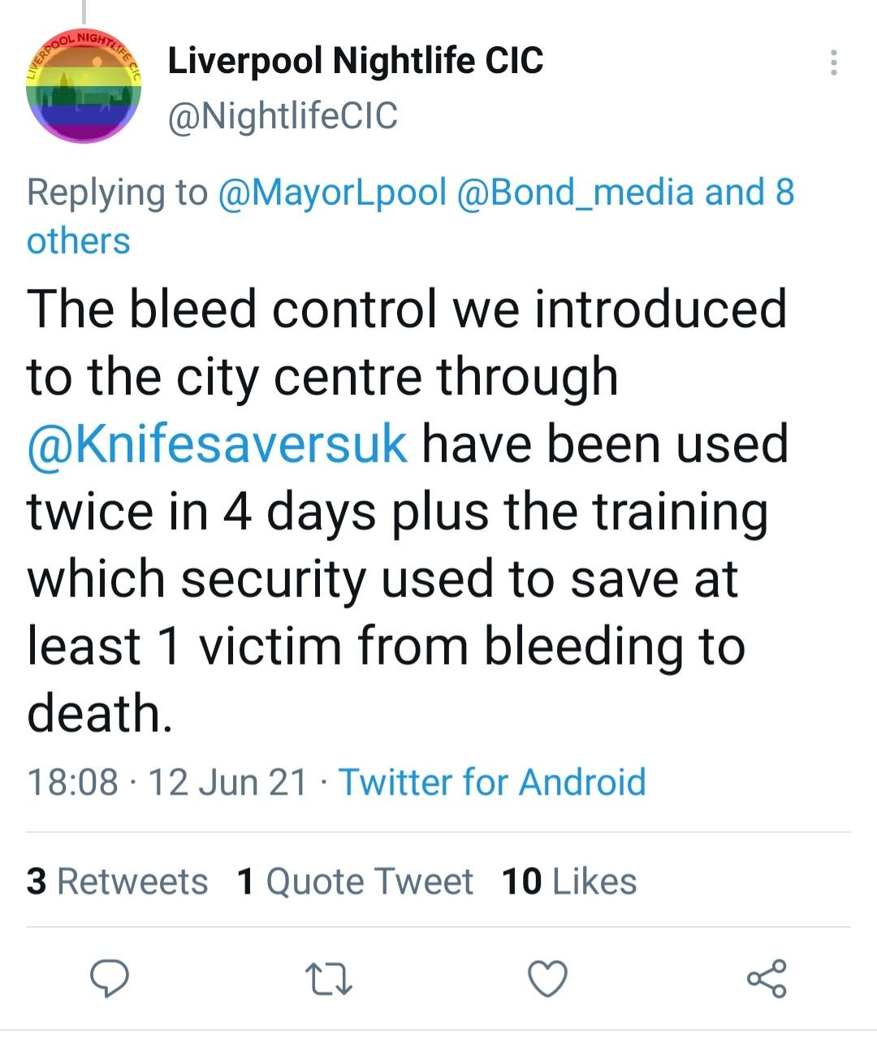
Is it worth it?

Slide 16
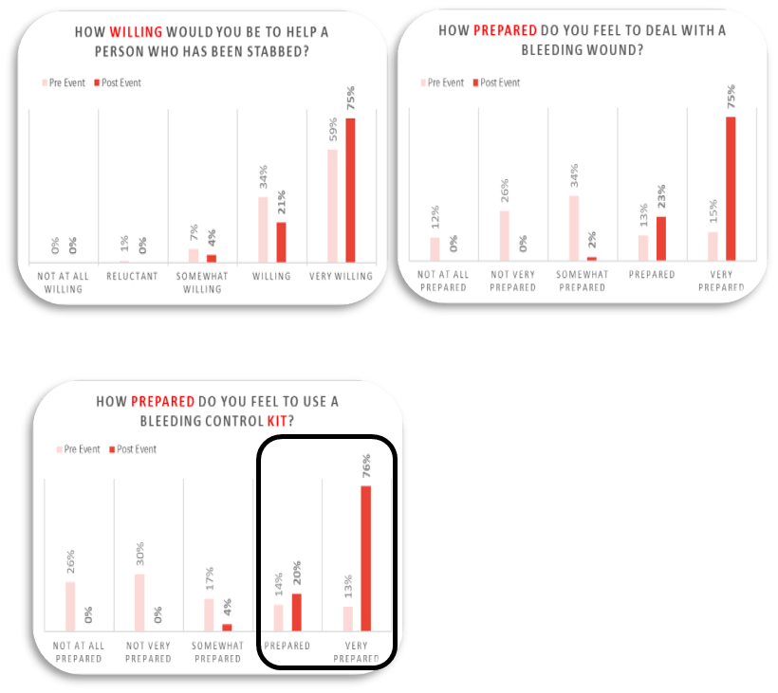
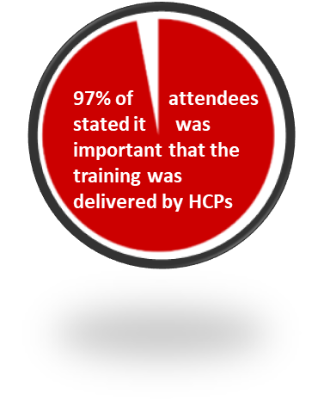

Slide 17
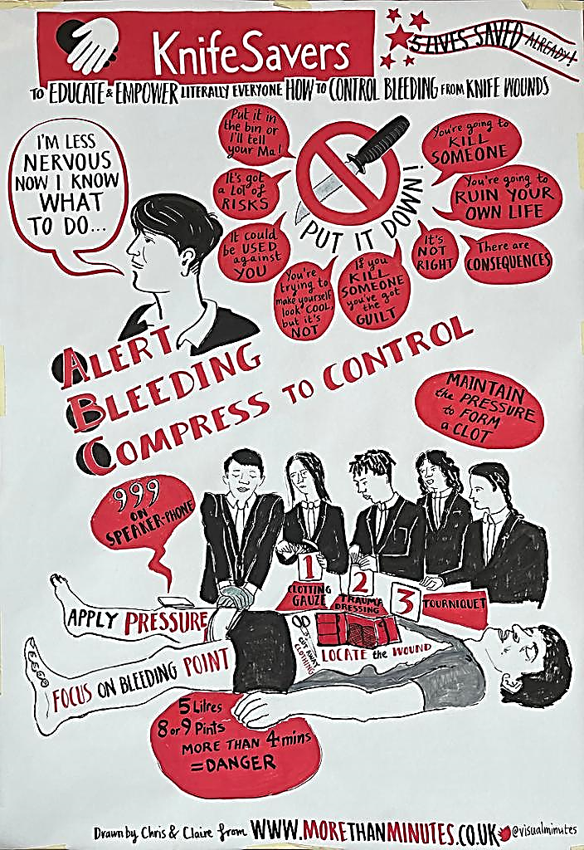
What’s Next?

Slide 18
Info@knifesavers.co.uk
Education@knifesavers.co.uk

