Slide 1
How Time-Matters UK supports children and young people impacted by parental imprisonment to thrive.
Dr Lorna Brookes.
Reader in Parental Imprisonment at LJMU
Founder of TMUK
MVRP Conference 15th January 2025

Slide 5
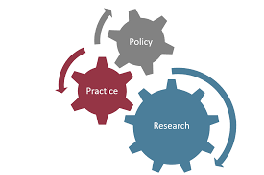
It's not your fault
You are not alone
Should not be considered as being a risk of becoming offenders like their parent who went to prison.
Should however been understood as children and young people who have an ACE or multiple ACE's

Slide 6
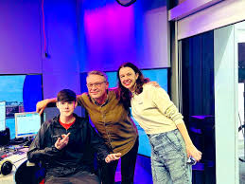
International Child Peace Prize 2023
30 under 30:
The young people inspiring the next generation in Merseyside
“What has happened to you is not your fault, and having a parent in prison does not define you"

Slide 7
A new training resource for Merseyside Police based on Interviews with young people from TMUK.
How they think police could do better to consider children during a parent’s arrest.
This is some of the things they said to us:
What their experience was like;
All had witnessed their parents getting arrested.
We asked them….
What their experience of the police were and how it affected them;

Slide 8
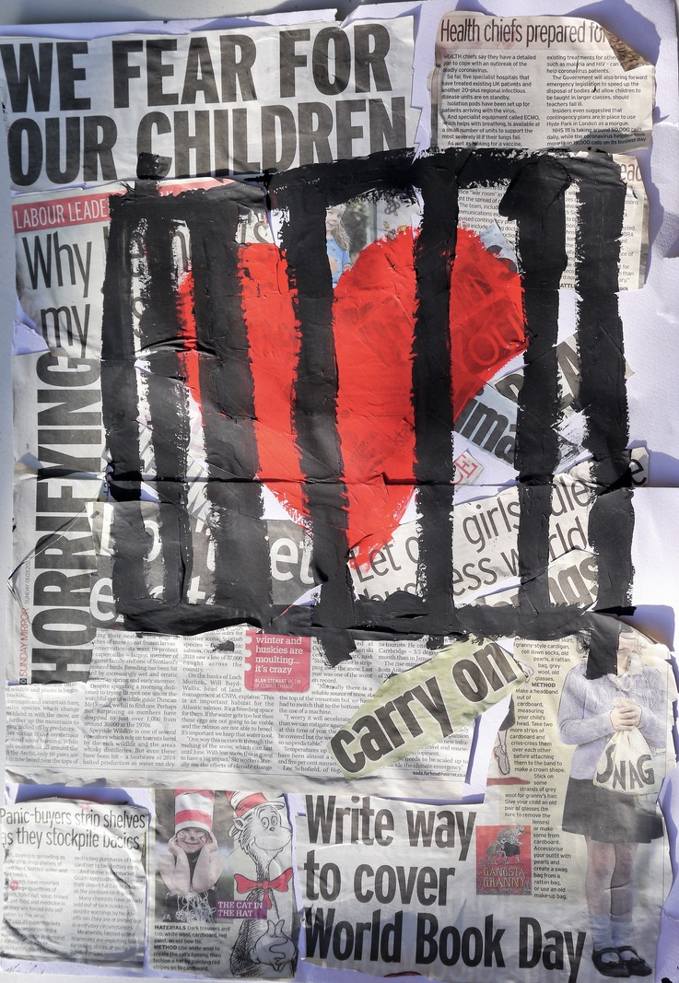
The experiences of young people impacted by parental imprisonment in relation to their parents’ crime being reported in the press.
Shock / Shame / Loss of privacy
Community backlash / Being unsafe
Not wanting to go to school / college
Inaccuracies, untruths, sensationalism
Non-offending family members self-isolating

Slide 9
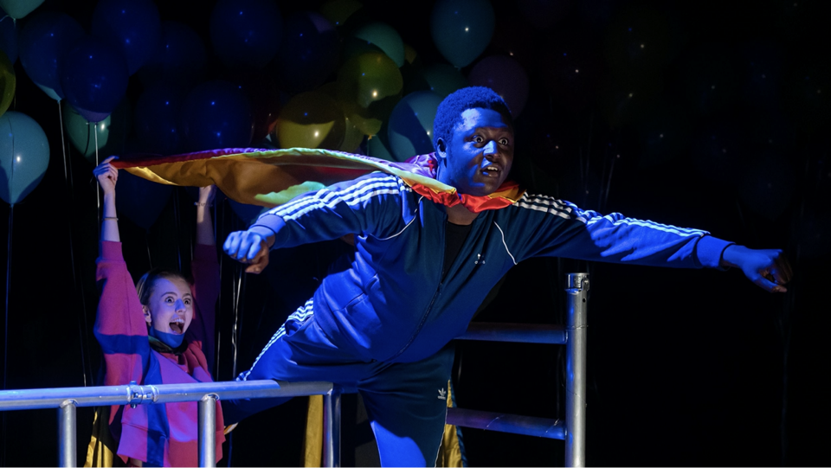
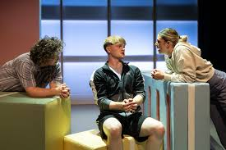
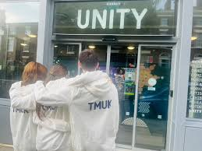
8 Hours There & Back
https://www.youtube.com/watch?v=mayi8_Htw2E

Slide 10
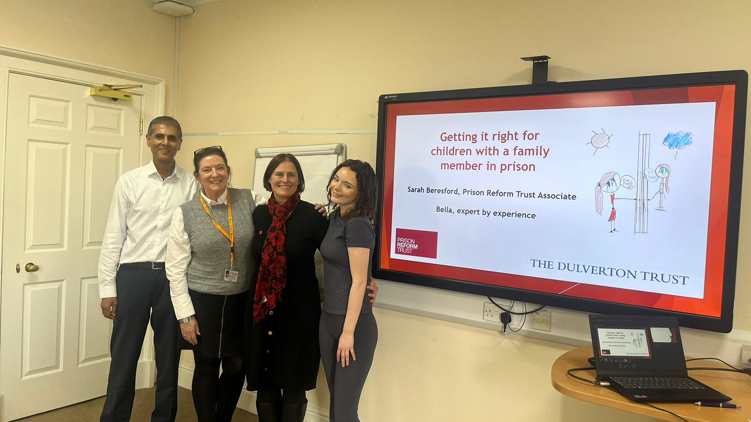

Slide 11
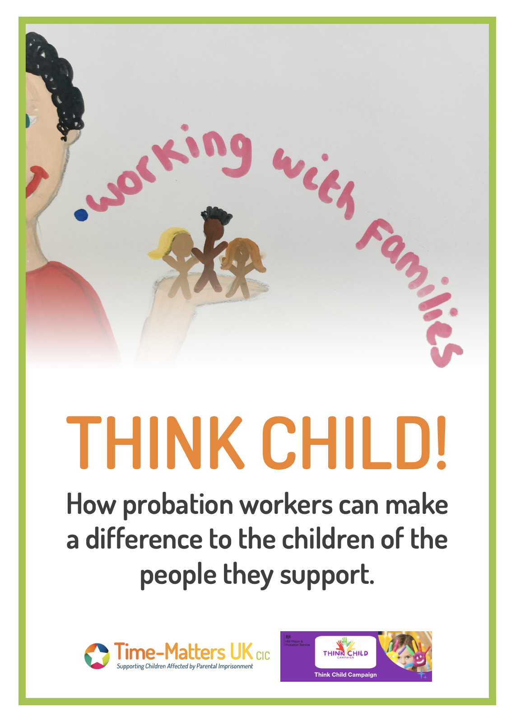
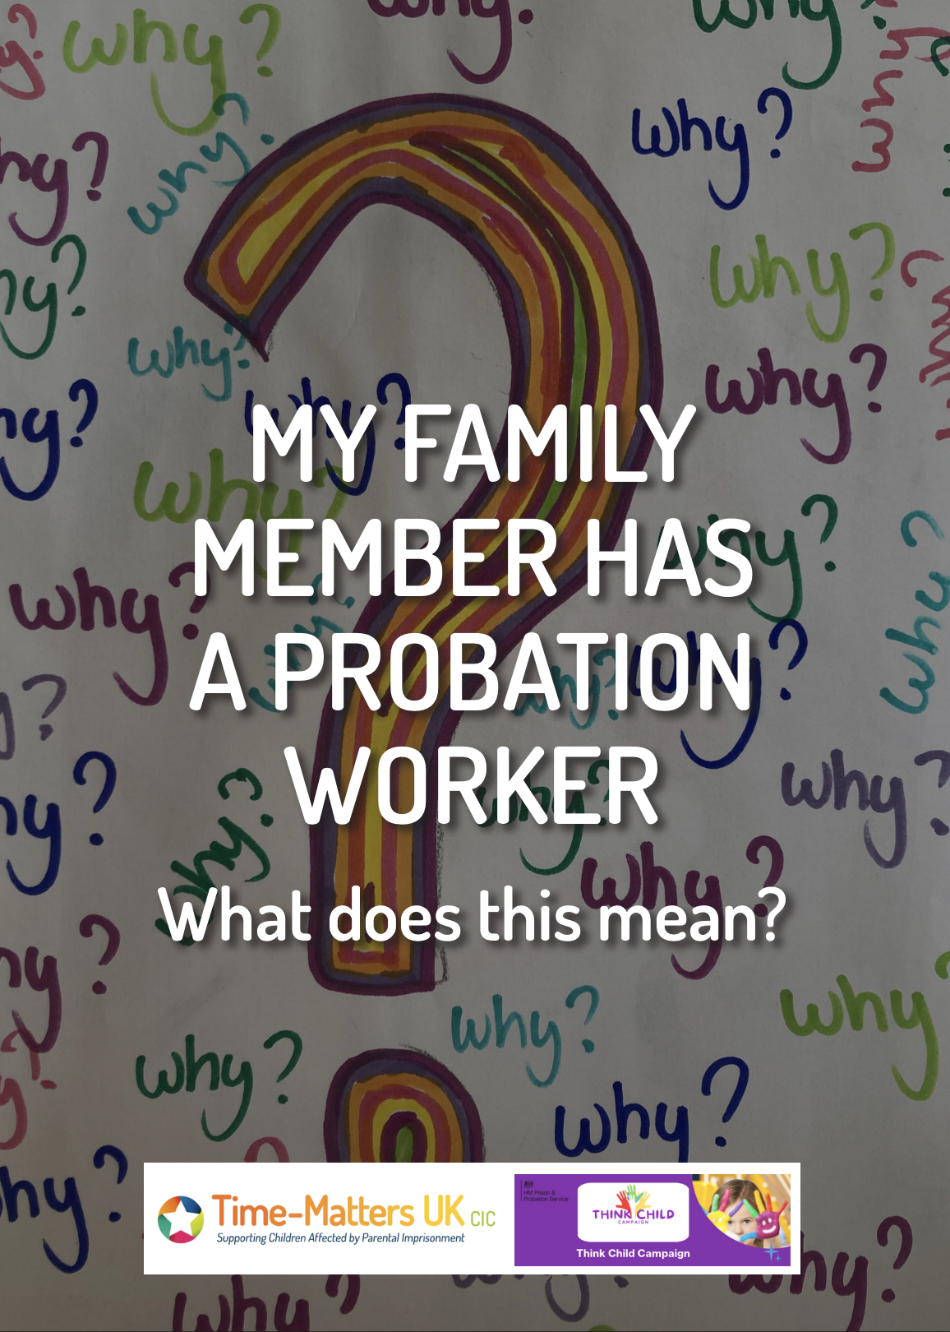

Slide 12
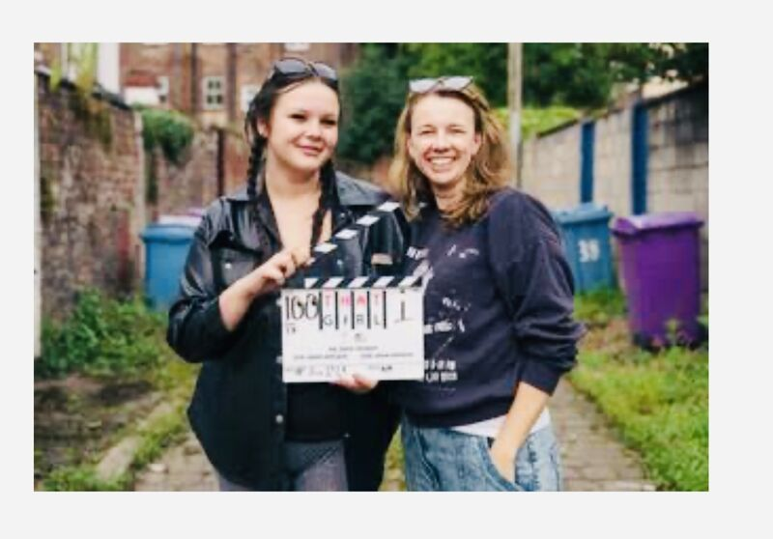
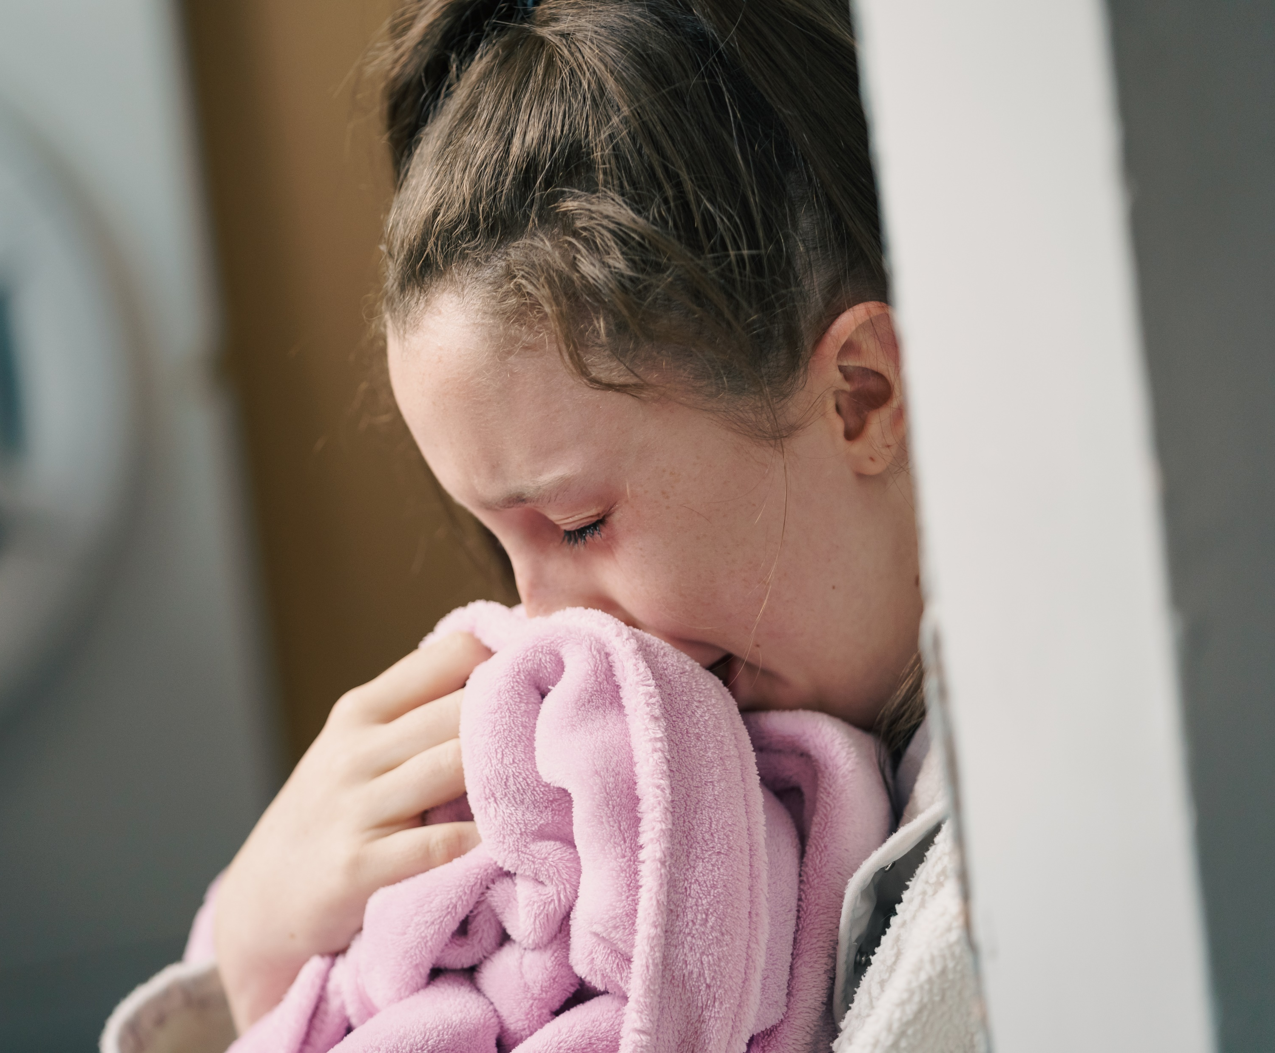
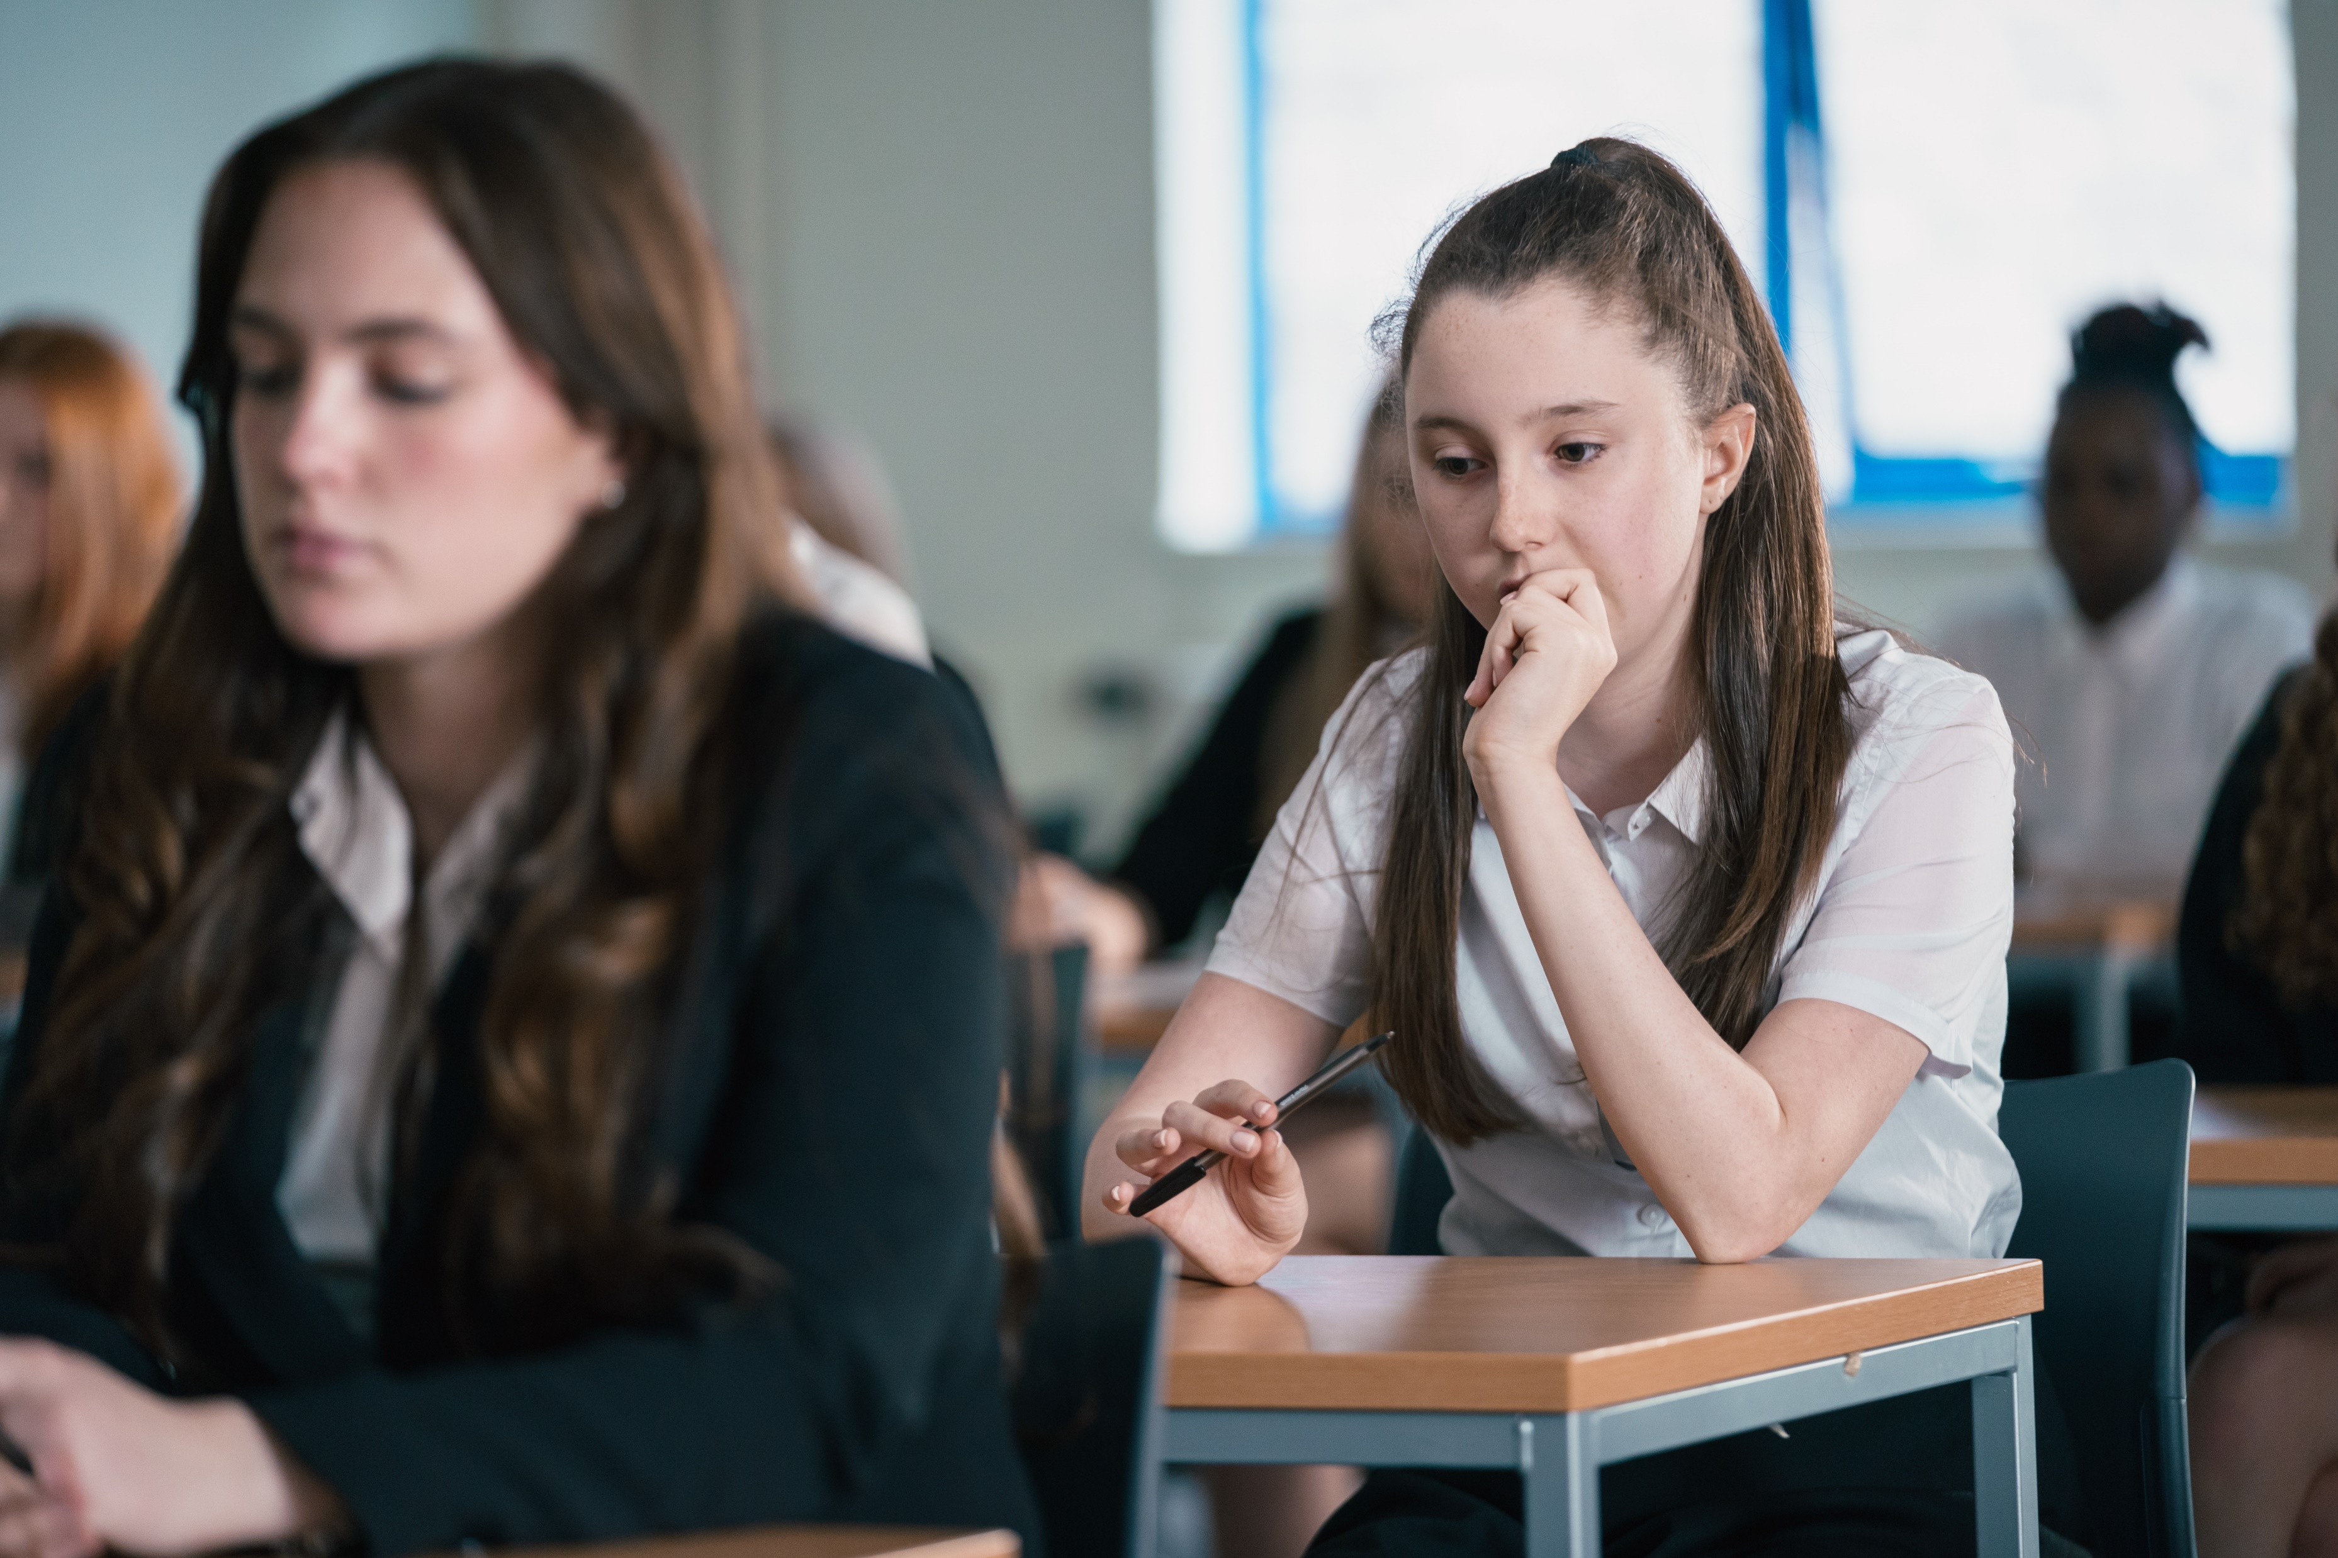
“That Girl” : Coming soon in 2025

Slide 13
Listen. Practice. Research. Change.
Brookes, L. 2024. “Safe Together”. A Reflection of a Therapeutic Art Programme for Children Impacted by Parental Imprisonment. Probation Journal.
Brookes L, Daly A. 2024. “Picture this, picture me”: community-based peer-to-peer and family support for children impacted by parental imprisonment. Journal of Children's Services.
Brookes L, Frankham J. 2021. The hidden voices of children and young people with a parent in prison: What schools need to know about supporting these vulnerable pupils International Journal of Educational Development
Brookes L. 2021. Forward: It’s not right! How children and young people, impacted by parental imprisonment, experience child rights. Donson F, Parkes A. Parental Imprisonment and Children’s Rights Routledge.
Brookes L. 2020. Practical Support for Children with a Mother in Prison: Reflections from a Practitioner. Mothering from the Inside Research on motherhood and imprisonment.
Brookes L. 2018. Why we need to listen to children of prisoners European Journal of Education.
lorna@timemattersuk.com
L.M.Brookes@ljmu.ac.uk

