Slide 1
Beacon Counselling Trust
Ian Whiteside
Early Intervention and Education Programme Manager
Beacon Counselling Trust – Arresting Gambling Related Harms
E: ian.whiteside@beaconcounsellingtrust.co.uk
T: 0151 226 0696
ian.whiteside@beaconcounselling.trust.co.uk

Slide 2
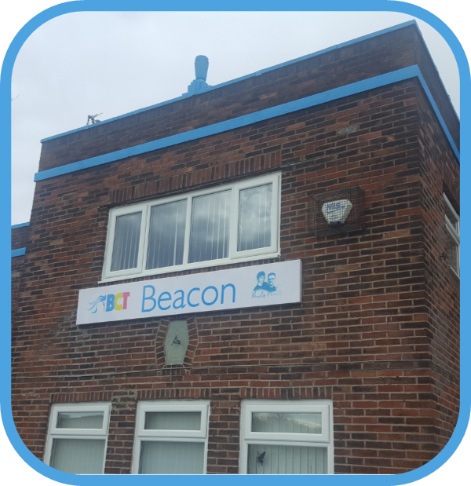
Beacon Counselling Trust
Mild - Moderate Mental Health Service Provider Established 2009
Located in Northwest England - Area 5,469 sq miles
Cumbria, Lancashire, Merseyside, Greater Manchester and Cheshire
Third most populated region in the UK (7,052m)
Core Programmes Include:
Eating Disorders / Weight Management
IAPT
Children and Young People
Armed Forces Community
Suicide Bereavement Specialist Postvention
National Gambling Support Network
ian.whiteside@beaconcounselling.trust.co.uk

Slide 3
Gambling Related Harms
A Public Health Issue
“The evidence is clear – harmful gambling is a public health issue and needs addressing on many fronts…”
Rosanna O’Connor, Director of Alcohol, Drugs, Tobacco and Justice
Public Health England (2021)
ian.whiteside@beaconcounselling.trust.co.uk

Slide 4
Defining Gambling and Gambling Related Harms
Gambling
'To stake or risk money, or anything of value, on the outcome of something involving chance.'
Gambling Related Harms
'Gambling-related harms are the adverse impacts from gambling on the health and wellbeing of individuals, families, communities and society.
These harms impact on people’s resources, relationships and health.'
ian.whiteside@beaconcounselling.trust.co.uk

Slide 5
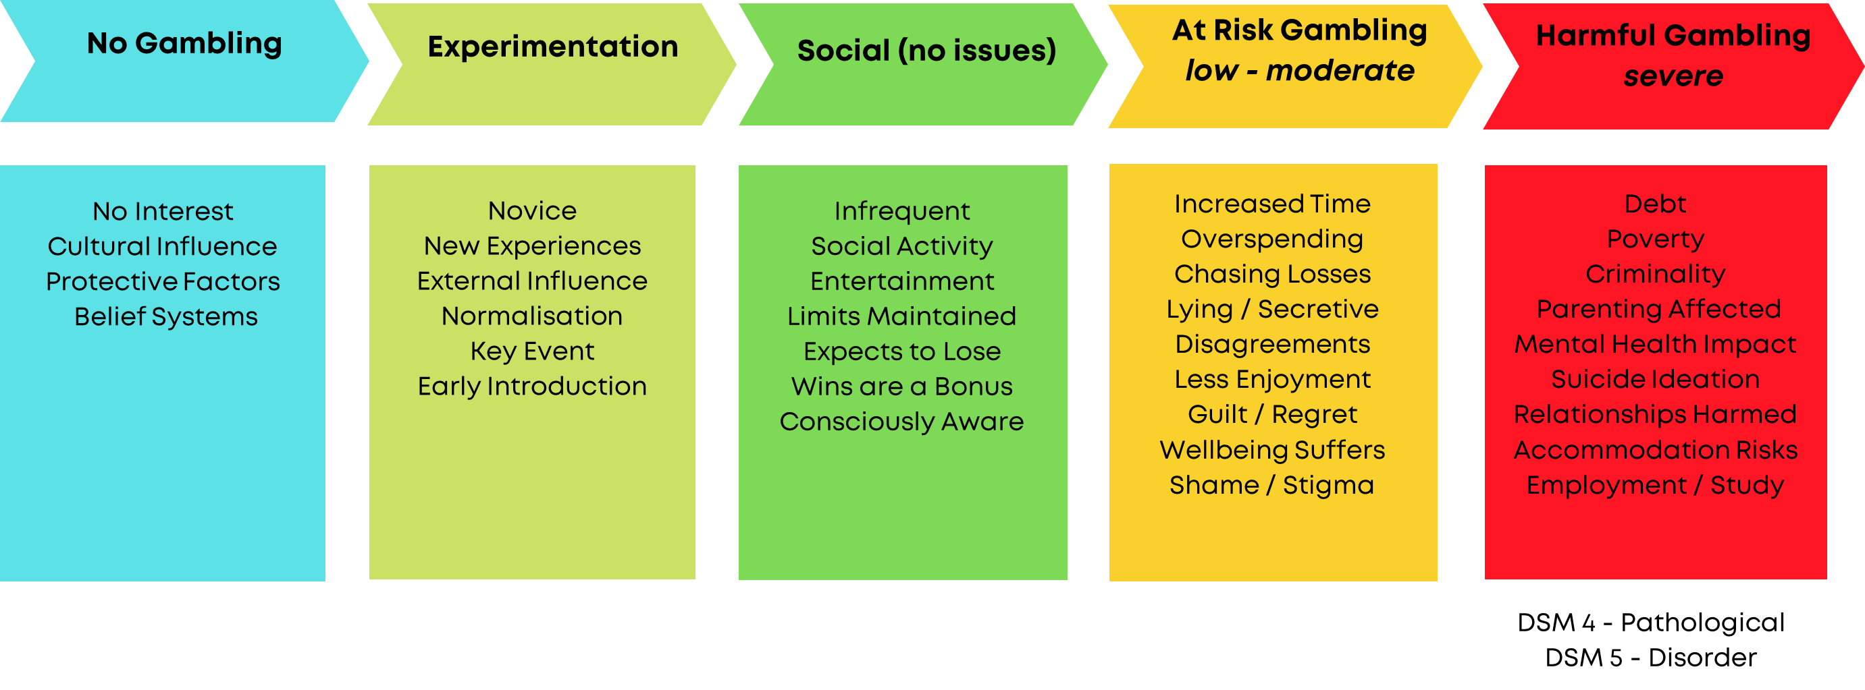
The Gambling Continuum
ian.whiteside@beaconcounselling.trust.co.uk

Slide 6
Gambling Harm Risk Factors
Early/significant win
Money Problems
Easy Access
Substance/alcohol misuse
Adverse childhood
experiences
Mental Health Illness
Self esteem issues
Risk Takers
Mistaken beliefs
Bored
Significant Life Events
eg divorce, breavement
No way to monitor
wins and losses
No interests or hobbies
Parents have gambling issues
ian.whiteside@beaconcounselling.trust.co.uk

Slide 7
Gambling Related Harms –Facts & Figures
The online gambling participation rate is 27%. Gambling Commission (2023)
2023 Industry annual Gross Gambling Yield (GGY).
£15.1 billion. Approximately 10% spend on advertising
48% of adults gambled in the last month and 61% in the last 12 months. Estimated to be 24 million people. Gambling Commission (2024) / GambleAware (2023)
Approximately 6 - 10 people are adversely impacted by another individuals gambling. Estimates suggest that there are 4.3 Million 'affected others' in the UK
50% of young people aged
11-16 report that they have gambled in the last year (2023)
13.1% of people (6.8 million) report experiencing gambling related harm.
2.9% score 8+ on pgsi GambleAware (2023)
44,000 calls made to the national gambling helpline. GamCare (2023)
6,645 people accessed treatment services between 2022 - 23. Reflects les than 3% based on those estimated to suffer harms
Harmful gambling increases the risk of suicide by up to 15 times. Karlsson and Hakansson (2018)
ian.whiteside@beaconcounselling.trust.co.uk

Slide 8
Young People as 'Affected Others’ / ACE’s
1 in 20 will loose out on spending time with a parent or carer
1 in 100 were prevented for attending clubs or activities they enjoy
1 in 80 are exposed to more arguments and tension at home
1 in 110 were prevented for going on trips, family holidays or school outings
1 in 90 did not have enough food at home or on their school dinner account
1 in 140 were often worried about gambling within their family
37% of individuals experiencing gambling harm reported being the perpetrators of Domestic Violence, mostly towards partners with emerging evidence suggesting that this violence also extends towards children
Early exposure to gambling increases risk of gambling harms up to 10 times
Source: Gambling education network (2022)
ian.whiteside@beaconcounselling.trust.co.uk

Slide 9
GambleAware - Area Data Profiles Merseyside (2023)
Authority | PGSI Low +1 GB 7.5% | PGSI Mod +3 GB 3.0% | PGSI +8 GB 2.9% | Treatment presentation pgsi scores 8+ Great Britain 66.4% | Fiscal Impact
Sefton | 6.7% < | 3.4% > | 2.1% < | 65.5% < | £4,145,335
Liverpool | 7.1% < | 4.0% > | 2.9% > < | 68.1% > | £10,140,883
St Helens | 7.1% < | 3.6% > | 2.4% < | 59.8% < | £3,093,478
Knowsley | 7.1% < | 3.9% > | 2.6% < | 63.1% < | £2,744,933
Wirral | 7.0% < | 3.3% > | 2.7% < | 60.3% < | £6,076,521
Halton | 7.5% > < | 3.6% > | 2.4% < | 61.7% < | £2,199,452
Source: National Institute of Economic and Social Research (NIESR (2023) The Fiscal Costs and Benefits of Problem Gambling
ian.whiteside@beaconcounselling.trust.co.uk

Slide 10
The 10 Point Plan
Mobilising Local Systems
Awareness
Treatment
Pathways
Assist
Approach
Screening
Place Platforms
Map Services
The Charter
Early Intervention
ian.whiteside@beaconcounselling.trust.co.uk

Slide 11
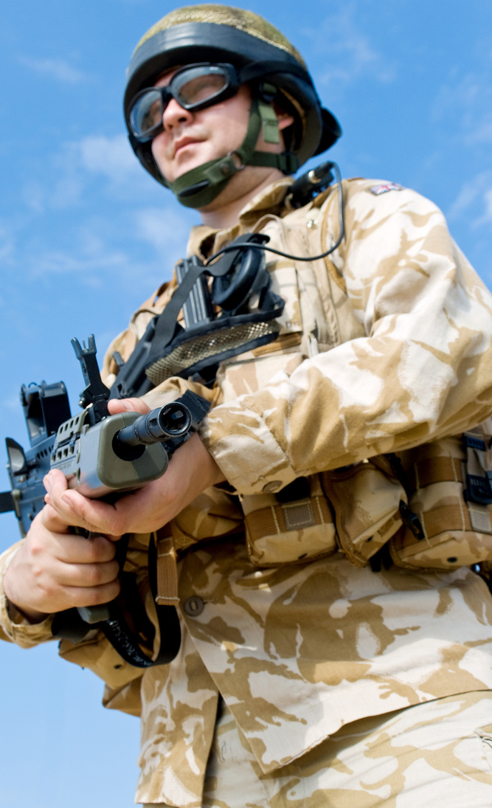
Gambling Related Harms Initiatives
Young Peoples
Programme
'Breaking the
Sharam' Project
'Six to Ten'
Families Support
The Workplace
Charter
Criminal Justice
Programme
Armed Forces Community
ian.whiteside@beaconcounselling.trust.co.uk

Slide 12
A Workplace Charter to Reduce Gambling Related Harms
Developing a Framework
'Bet You Can Help' Offer
Public Health Issue Parity
ian.whiteside@beaconcounselling.trust.co.uk

Slide 13
The Charter Signatories
Durham Constabulary First UK Police Force Signatory April 2023
Cheshire Constabulary the First Northwest Force Signatory August 2023
Joy Allen, Durham PCC and Jo Farrell Chief Constable, signing on behalf of Durham Constabulary
Mark Roberts, Chief Constable, and members of Cheshire's HR Team attending Cheshire Constabulary signing ceremony

Slide 14
Workplace Charter Signatories
ian.whiteside@beaconcounselling.trust.co.uk

Slide 15
‘Bet You Can Help’
Training Programme
Accredited training programme. Level 2 RSPH Award in Tackling Gambling Related Harms – a practical first aid approach to the issue
Promotes community-based focused brief advice & interventions aimed at six key vulnerable groups such as:
Diverse Communities
Criminal Justice System
'Affected Others'
Workplace Charter Signatories
Armed Forces Community
Homeless
'Bet You Can Help Now' 1.5-hour session option
Programme Collaborator's
Complementary Handbook
ian.whiteside@beaconcounselling.trust.co.uk

Slide 16
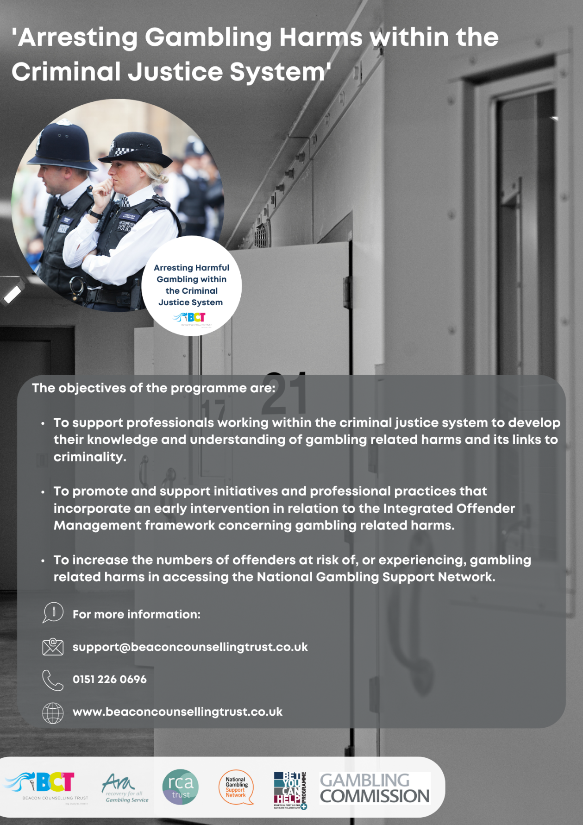
Gambling Related Harms Training
For more information:
support@beaconcounsellingtrust.co.uk
0151 226 0696
www.beaconcounsellingtrust.co.uk
Arresting Harmful Gambling within the Criminal Justice System
ian.whiteside@beaconcounselling.trust.co.uk

Slide 17
Gambling and Criminality
Serious and organised crime
Community violence and homicide
Pre-planned criminality (Theft and major fraud)
Theft from employers/organisations due to
accessibility/opportunity
Low / Moderate Risk Gambling – Severe Gambling Harms
Engagement with illegal money lending, domestic violence, larger domestic thefts, credit card and mortgage fraud
Minor thefts from friends and family, domestic
abuse, intimidation and threatening behaviour,
child abandonment
ian.whiteside@beaconcounselling.trust.co.uk

Slide 18
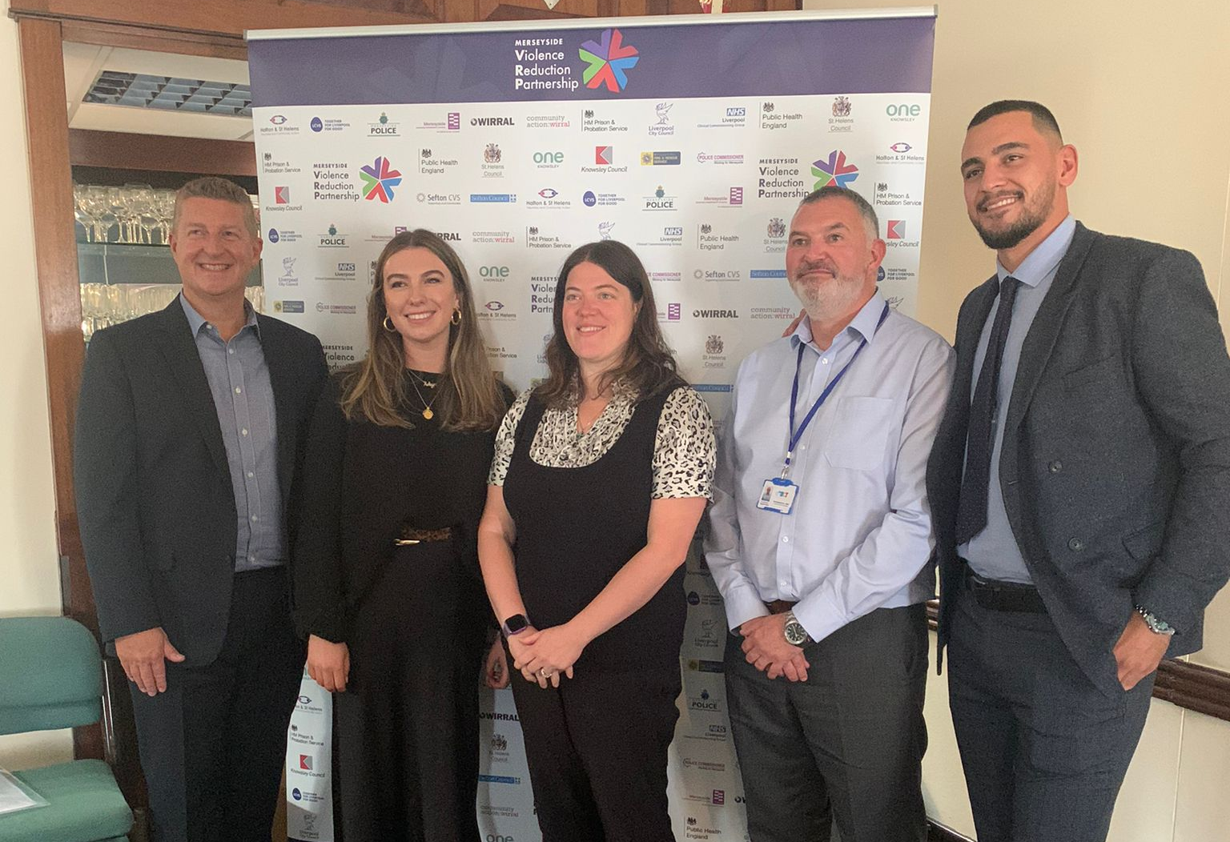
Merseyside Violence Reduction Partnership
Collaborations
September 2022 – CPD Seminar ‘Gambling with Young People’s Lives’
Training developments across LCR
Nov 2023 – ‘Club Health’ Liverpool 2023
May 2024 – ‘A Whole Families Approach to Gambling Related Harms’
June 2024 – ‘Kind to Your Mind’ – Linked to Euro’s 2024 with Liverpool City Council Public Health
Liverpool JMU – ACES research funded by MVRP featuring gambling related harms
For more information:
support@beaconcounsellingtrust.co.uk
0151 226 0696
www.beaconcounsellingtrust.co.uk
CPD Seminar ‘Gambling with Young People’s Lives’ Sept 2022
ian.whiteside@beaconcounselling.trust.co.uk

Slide 19
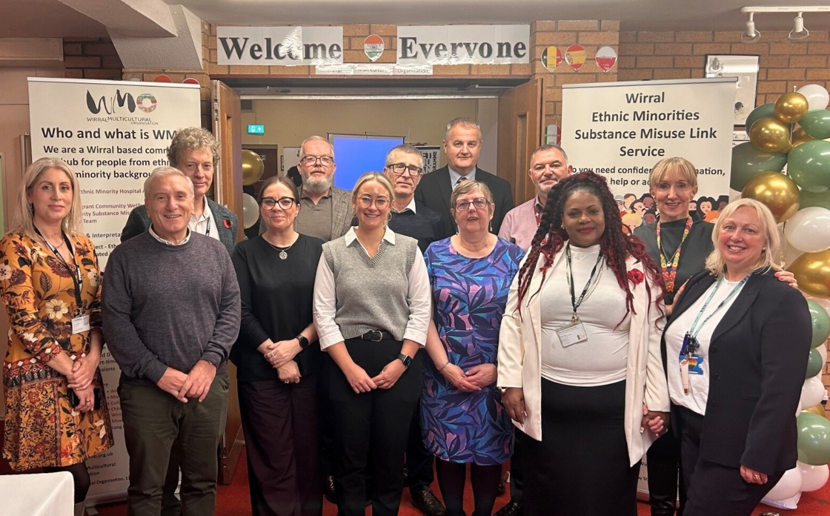
Merseyside Police
Collaborations
Gambling harms training included in Custody Suite staff induction
Gambling harms training to Psychological Services / Occupational Health Service
Project ADDER officers supporting gambling related harms initiatives and promotion of training to drugs and alcohol services partners
Vulnerable Persons Referral Unit – gambling screening questions added to process in September 2024: 36 referrals
Wirral Multicultural Organisation – gambling section added to website with language translation function
RSPH accredited ‘Bet You Can Help’ training programme
Wirral Multicultural Organisation Nov 2024
ian.whiteside@beaconcounselling.trust.co.uk

Slide 20
Treatment Provision
Northwest Treatment Provider
Individuals at risk of, or experiencing, gambling related harms including ‘affected others’
Contact made within 48 hours
Comprehensive assessment
8-to-12-week treatment programme
6-to-8-week support for AO
Onward referral to Tier 4
Aftercare & ongoing support
No waiting lists
ian.whiteside@beaconcounselling.trust.co.uk

Slide 21
How we address gambling related harms
Psychoeducation
Practical tools – urge surfing, self-exclusion etc
Trauma-informed interventions
Meaningful and fulfilling activities – 5 Ways to Wellbeing
Connection with others – social and peers with Lived Experience
Support with legacy harms
Whole family's approach
Place-based approach – engagement with PH, NHS, third sector
Raise awareness to improve referral pathways through education and prevention
Aftercare support following treatment
Onward referral
Education & Prevention
Treatment & Support
ian.whiteside@beaconcounselling.trust.co.uk

Slide 22
GRACE Video
For more information:
support@beaconcounsellingtrust.co.uk
0151 226 0696
www.beaconcounsellingtrust.co.uk
ian.whiteside@beaconcounselling.trust.co.uk

Slide 23
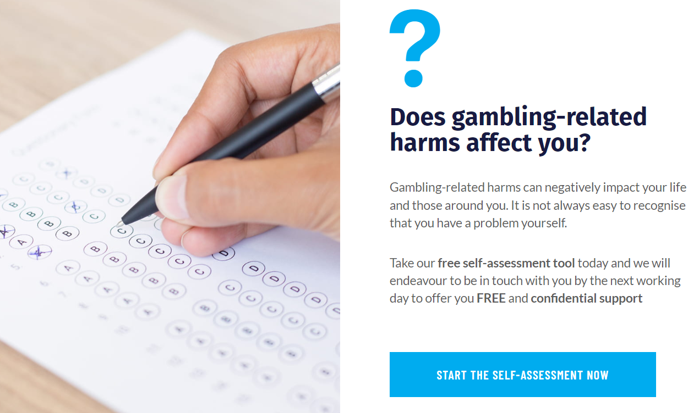
Thank You
FOLLOW AND CONTACT US
Phone: 0151 226 0696
Email: support@beaconcounsellingtrust.co.uk
Website: https://beaconcounsellingtrust.co.uk
Social media: @BCTNorthWest
ian.whiteside@beaconcounselling.trust.co.uk

